Slide 1



Integrative Genomics Unveils Transcription Factor Roles in Cellular Fate and Spatially Resolved Triple-Negative Breast Cancer Immunity Capacity
February 2024
Thesis Defense
Shaked Slovin
SEMM PhD student- Davide Cacchiarelli's Lab Armenise/Harvard Laboratory of Integrative Genomics
Notes:
First and foremost, I would like to express my gratitude. It is a great honor to have you here as members of my PhD committee for the thesis defense. Today, I will briefly present my thesis and would be happy to address any questions you may have at any point during the presentation, at your convenience.

Slide 2

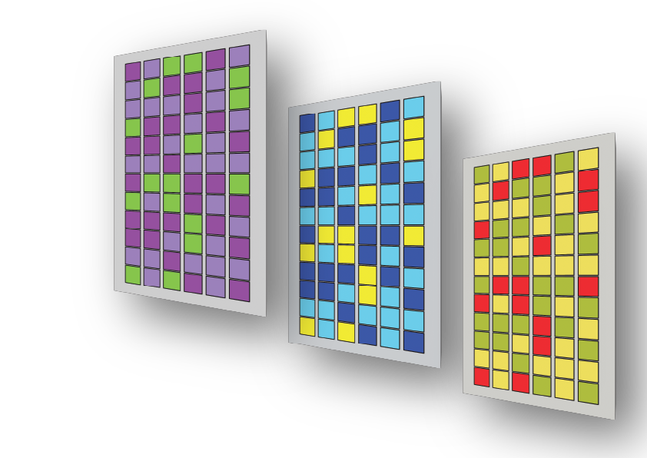


Integrative Genomics: A Cornerstone Scientific Approach in This Thesis
Integrative Genomics
High-Throughput Technologies and Computational Analysis
Data Integration and Systems Biology
Functional Annotation and Validation
Notes:
In this thesis, I employ core principles of integrative genomics, including high throughput sequencing techniques, computional methods to analyze each omic data and integrate it to achieve a more comprehensive understanding , eventually leading to functional annotations and validation strategies in order to investigate two interrelated projects. 1) “An Integrated Screening to Infer Transcription Factor Regulatory Networks Governing Cell Fate Decisions” - aims to explore both well-established and yet uncharacterized TFs regulatory affect om cell fate dcisions ; 2) “Spatial Transcriptomics Reveals Sub-Tumoral Identities and Novel Diagnostic Markers in Triple Negative Breast Cancer with Immune Evasion Capacity” – aims to on spatially resolving TNBC focusing on PD-L1 status with the goal of identifying alternative diagnostic markers.

Slide 3
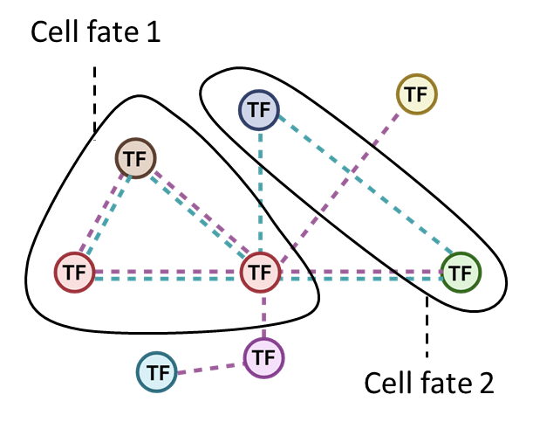
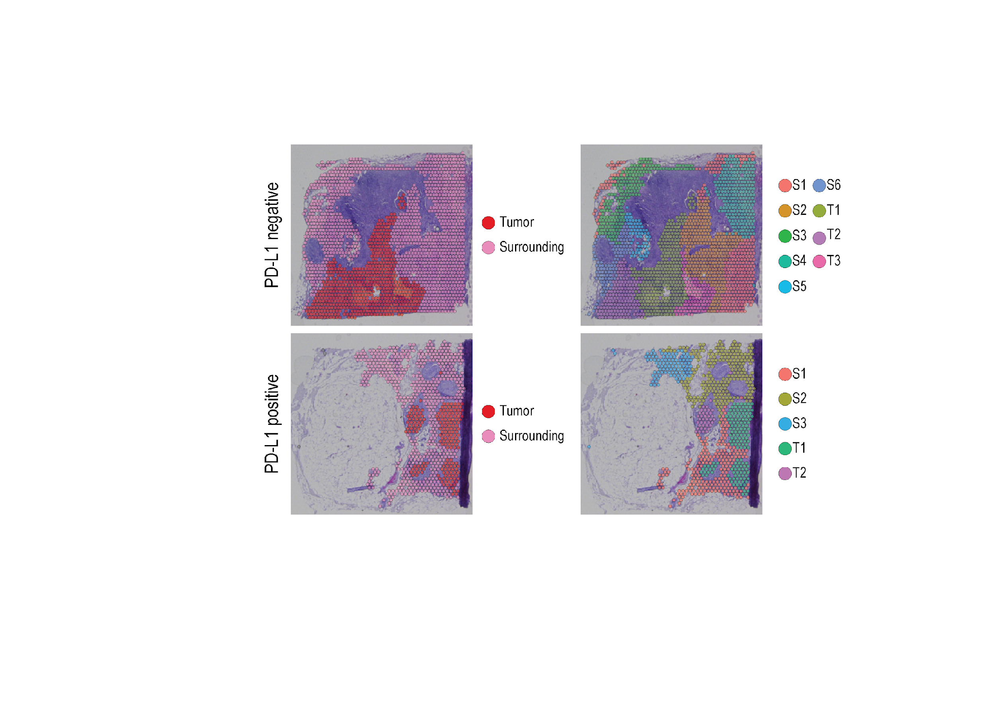
Integrative Genomics: A Cornerstone Scientific Approach in This Thesis
Integrative Genomics
High-Throughput Technologies and Computational Analysis
Data Integration and Systems Biology
Functional Annotation and Validation
First Project
Second Project
An Integrated Screening to Infer Transcription Factor Regulatory Networks Governing Cell Fate Decisions
Spatial Transcriptomics Reveals Sub-Tumoral Identities and Novel Diagnostic Markers in Triple Negative Breast Cancer with Immune Evasion Capacity
Notes:
In this thesis, I employ core principles of integrative genomics, including high throughput sequencing techniques, computional methods to analyze each omic data and integrate it to achieve a more comprehensive understanding , eventually leading to functional annotations and validation strategies in order to investigate two interrelated projects. 1) “An Integrated Screening to Infer Transcription Factor Regulatory Networks Governing Cell Fate Decisions” - aims to explore both well-established and yet uncharacterized TFs regulatory affect om cell fate dcisions ; 2) “Spatial Transcriptomics Reveals Sub-Tumoral Identities and Novel Diagnostic Markers in Triple Negative Breast Cancer with Immune Evasion Capacity” – aims to on spatially resolving TNBC focusing on PD-L1 status with the goal of identifying alternative diagnostic markers.

Slide 4
Outline
First Project: An Integrated Screening to Infer Transcription Factor Regulatory Networks Governing Cell Fate Decisions
Introduction
Results
Summary and Insights
Second Project: Spatial Transcriptomics Reveals Sub-Tumoral Identities and Novel Diagnostic Markers in Triple Negative Breast Cancer with Immune Evasion Capacity
Introduction
Results
Summary and Insights
Notes:
Similarly to the structure of my thesis, I will present each introduction, results and summary and insights, starting from the first project

Slide 5
Outline
First Project: An Integrated Screening to Infer Transcription Factor Regulatory Networks Governing Cell Fate Decisions
Introduction
Results
Summary and Insights
Second Project: Spatial Transcriptomics Reveals Sub-Tumoral Identities and Novel Diagnostic Markers in Triple Negative Breast Cancer with Immune Evasion Capacity
Introduction
Results
Summary and Insights
Notes:
Similarly to the structure of my thesis, I will present each introduction, results and summary and insights, starting from the first project

Slide 6
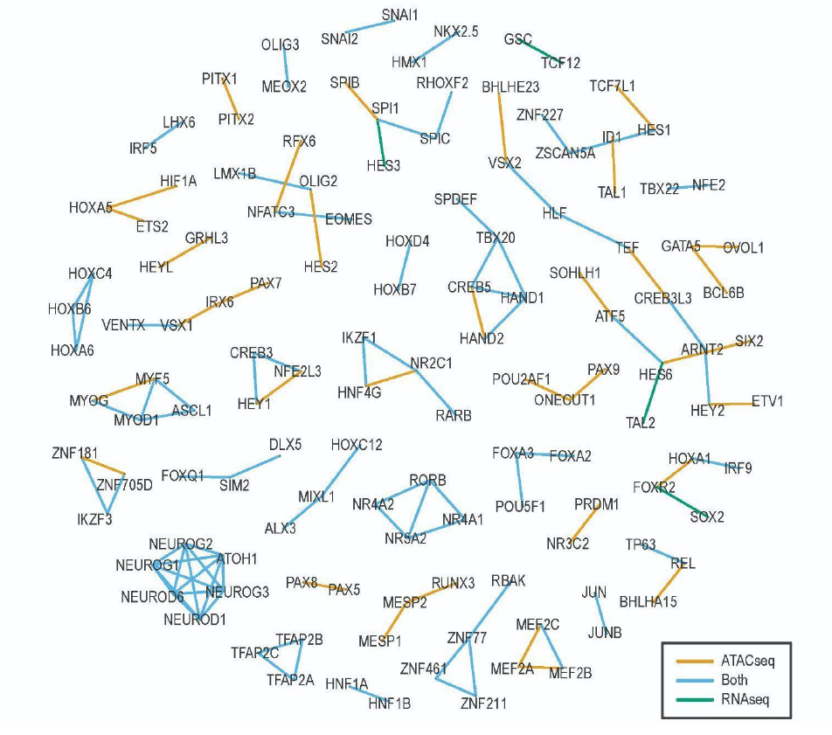
First Project
An Integrated Screening to Infer Transcription Factor
Regulatory Networks Governing Cell Fate Decisions
A comprehensive transcriptomic, epigenomic, and morphological screening of 130 well-established and yet uncharacterized TFs to apprise their individual or synergistic roles in shaping cellular fate.
Notes:
. In this project, we developed a comprehensive transcriptomic, epigenomic, and morphological screening of 130 developmental TFs to identify novel pioneer factors that, either individually or in combination, play a pivotal role in regulating cellular identity.

Slide 7
Outline
First Project: An Integrated Screening to Infer Transcription Factor Regulatory Networks Governing Cell Fate Decisions
Introduction
Results
Summary and Insights
Second Project: Spatial Transcriptomics Reveals Sub-Tumoral Identities and Novel Diagnostic Markers in Triple Negative Breast Cancer with Immune Evasion Capacity
Introduction
Results
Summary and Insights
Notes:
So ill fist strat with a short background on the state of the arts and current challenges in the filed

Slide 8
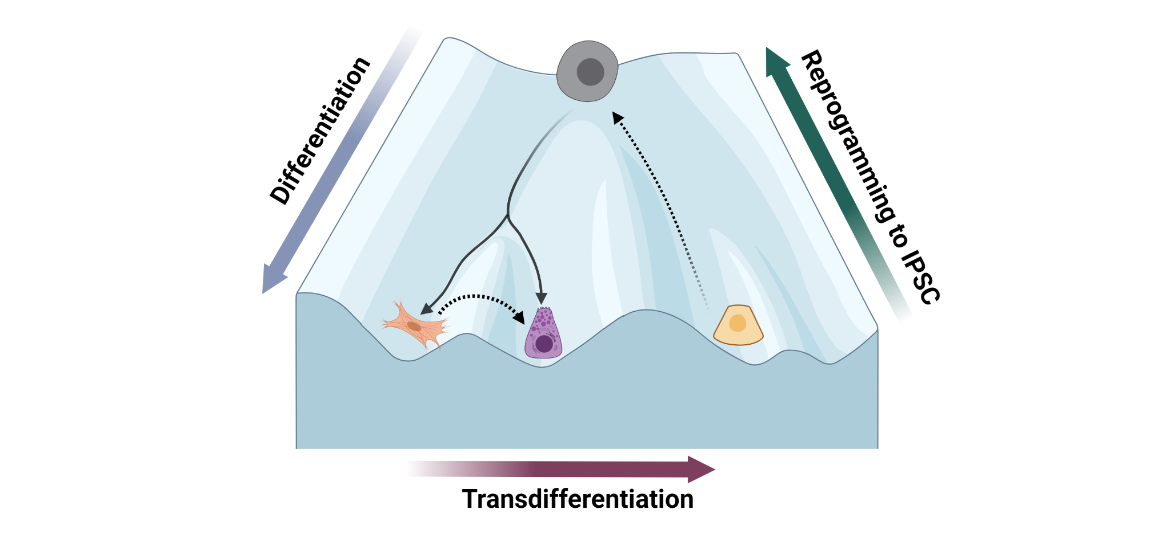
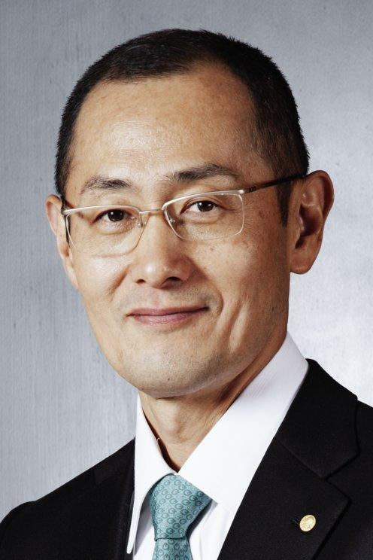
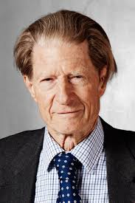
The paradigm-shifting discoveries of cellular reprogramming
In the last decades, the primary dogma that cellular differentiation was a unidirectional process has been shattered by the discoveries of cellular reprogramming to IPSC and transdifferentiation toward myogenic fate. This has led to a new school of thought in which an ectopic expression of a crucial subset of TFs can re-wire cellular identity.
2012 Nobel Prize in Physiology or Medicine
Prof. Shinya
Yamanaka
Sir John B.
Gurdon
Notes:
In the past decades, the primary dogma that cellular differentiation was a unidirectional process, has been shattered by the paradigm-shifting discoveries of cellular reprogramming who granted Yamnaka and Gordon with the nobel price on 2012. These discoveries have led to a new school of thought in which the forced expression of a subset of crucial TFs can revert cellular programmes. This concept has triggered an unprecedented boost in the study of TFs to precisely shape cellular fate in vitro.

Slide 9
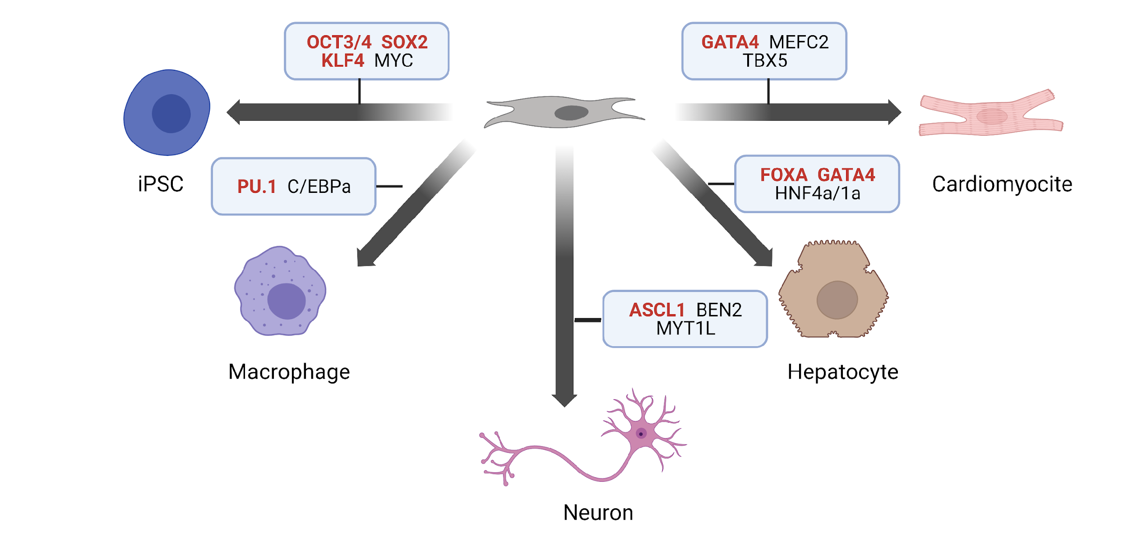
Pioneer Transcription Factors
Not all TFs possess the same functional capacity. Some factors, known as 'pioneer’ TFs, demonstrate higher functional capacity to re-wire cellular fate. These TFs can interact with heterochromatin, thereby enabling a more permissive cellular state that facilitates the recruitment of other co-factors to further drive the developmental progression.
Notes:
Recent studies have demonstrated that a set of TFs which mutually regulate specific developmental networks do not have an identical functional capacity in the mechanism of cell fate conversion. First, a dominant subset called “pioneer factors” initiates the competence toward a unique cell fate followed by recruitment of cofactors that further promote the progression through the developmental trajectory. ‘pioneer factors’ are dominant in their ability to
engage silent, unmarked chromatin and thus leading to the recruitment of other factors, thereby introducing new function to regulatory DNA sequences. As a result, existing cellular conversion methods employing at least one pioneer TF which initiates the commitment toward a unique cell fate. For example … remain inefficient and yield phenotypically immature cells
. Thus, studying the underlying mechanism of pioneer TFs and understand how they impart new functions to genome conformation and activity, constitute a fundamental topic in the field of developmental and stem cell biology. Understanding their underling mechanism will allow us to unlock the full potential
Of pioneer TF repertoire.

Slide 10
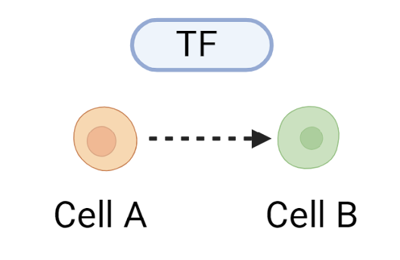
TF Functionality Constrained by Diverse Regulatory Mechanisms
Post-Translational
Modification
Chromatin
Accessibility
Non-Coding RNA Mediated Regulation
Signal Transduction Mediated Regulation
Co-regulatory Protein Interactions
Ligand-Induced
Activity Modulation
Notes:
However thereare numerus Regulatory Mechanisms that effect TF Functionality, including…
Therefore making it complicated to predict the global activity of TF in the context of rewiring cellular identity in vitro

Slide 11

Current challenges in the filed
Research in this field has mainly focused on identifying the most optimal TFs for generating specific target cell types of interest
Existing cellular conversion methods remain inefficient and yield phenotypically immature cells
Lack of a systematic workflow for side-by-side comparative analysis of TFs to apprise their global effect
Notes:
However thereare numerus Regulatory Mechanisms that effect TF Functionality, including…
Therefore making it complicated to predict the global activity of TF in the context of rewiring cellular identity in vitro

Slide 12

Project innovativeness
Understand unbiasedly how multiple TFs and their co-factors cooperate to activate or inhibit gene expression
Identify novel pioneer TFs and understand their role in cell fate alternation
Develop a state-of-the-art encyclopaedia of pioneer TF landscapes
Notes:
In this project, we propose for the first time an unbiased screening of ~300 different TFs potentially involved in developmental processes through a high-throughput multifaceted integrative genomic approach. This will ultimately lead to new paradigms in deciphering crucial dynamics that drive cell fate decisions and thus allow us to unlock the full potential of the TF repertoire.

Slide 13
Outline
First Project: An Integrated Screening to Infer Transcription Factor Regulatory Networks Governing Cell Fate Decisions
Introduction
Results
Summary and Insights
Second Project: Spatial Transcriptomics Reveals Sub-Tumoral Identities and Novel Diagnostic Markers in Triple Negative Breast Cancer with Immune Evasion Capacity
Introduction
Results
Summary and Insights
Notes:
So with no further due I’ll start with a brief introduction Before diving into details. So as you may know the competence of cells to a vast array of cell typesis the driving mechanism for the development of any multicellular organism. First, cellular differentiation was defined as the processes werw potent cell
is programmed to an other functional cell. This processes orchestrated by external spatiotemporal signaling which prominently act through tight regulation of transcription factors (TF). During such, distinct combinations of TFs alternate the cell states through a series of chromatin remodeling events and transcriptional program modulations, thus dramatically affect cellular characteristics by committing to a unique differentiation course.

Slide 14
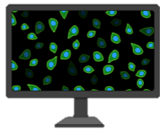
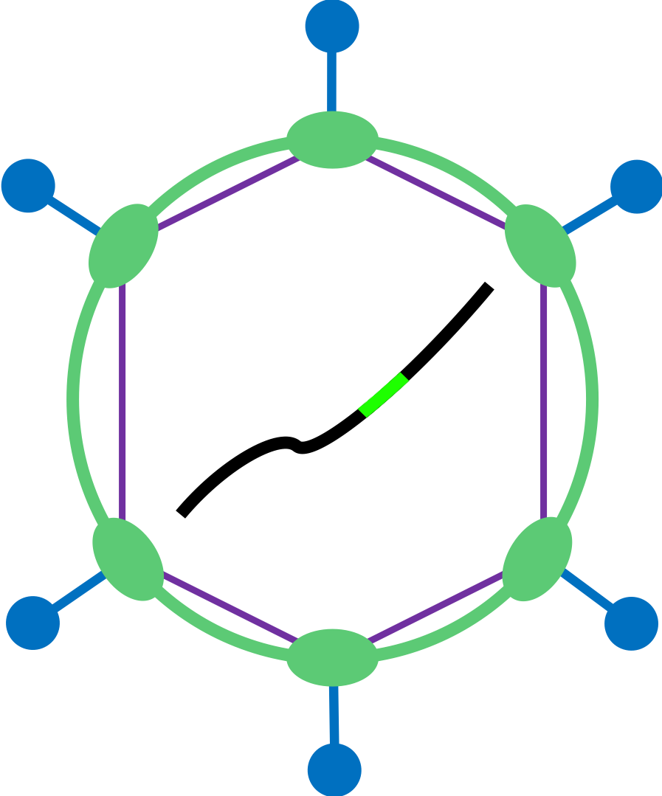

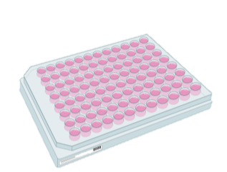


Project workflow
Morphological screening
Potential TF list selection
Cellular conversion
Fused similarity network
Transcriptomic and epigenomic screening
RNAseq
ATACseq
*Lorenzo Vaccaro
*Antonio Grimaldi
Notes:
In this project, we propose for the first time an unbiased screening of ~300 different TFs potentially involved in developmental processes through a high-throughput multifaceted integrative genomic approach. This will ultimately lead to new paradigms in deciphering crucial dynamics that drive cell fate decisions and thus allow us to unlock the full potential of the TF repertoire.

Slide 15
Project workflow
Morphological screening
Potential TF list selection
Cellular conversion
Fused similarity network
Transcriptomic and epigenomic screening
RNAseq
ATACseq
*Lorenzo Vaccaro
*Antonio Grimaldi
Notes:
In this project, we propose for the first time an unbiased screening of ~300 different TFs potentially involved in developmental processes through a high-throughput multifaceted integrative genomic approach. This will ultimately lead to new paradigms in deciphering crucial dynamics that drive cell fate decisions and thus allow us to unlock the full potential of the TF repertoire.

Slide 16
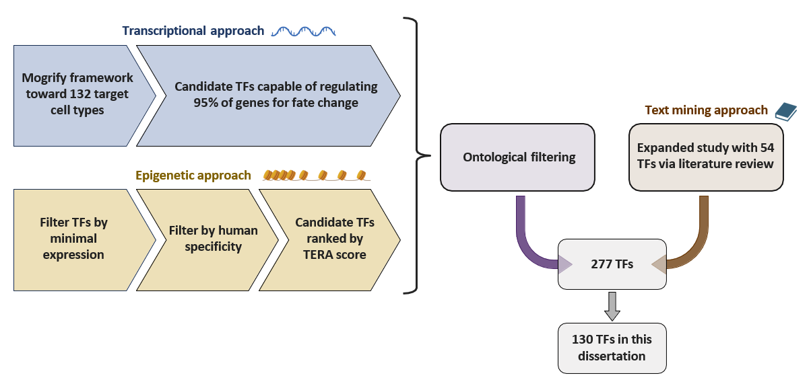
Candidate TFs Selection and Prioritization
Notes:
In this project, we propose for the first time an unbiased screening of ~300 different TFs potentially involved in developmental processes through a high-throughput multifaceted integrative genomic approach. This will ultimately lead to new paradigms in deciphering crucial dynamics that drive cell fate decisions and thus allow us to unlock the full potential of the TF repertoire.

Slide 17
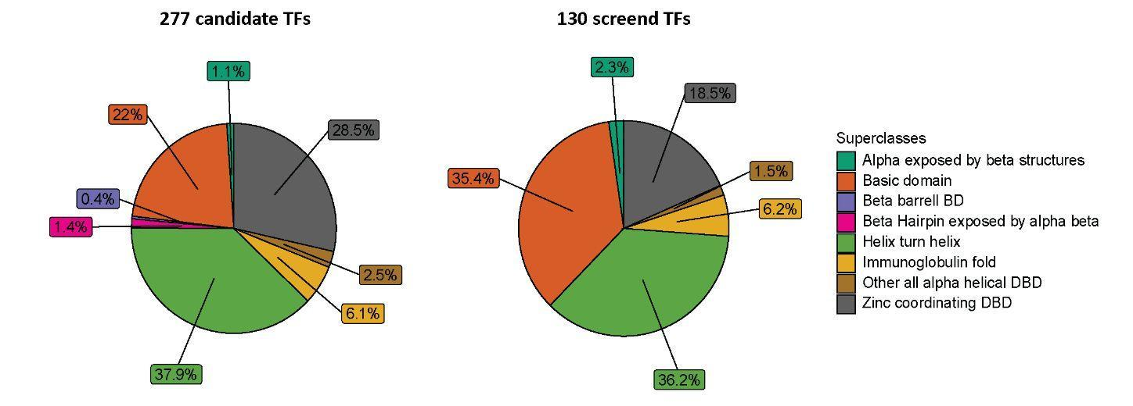
Superclass Representation in Candidate TFs Portfolio
Notes:
In this project, we propose for the first time an unbiased screening of ~300 different TFs potentially involved in developmental processes through a high-throughput multifaceted integrative genomic approach. This will ultimately lead to new paradigms in deciphering crucial dynamics that drive cell fate decisions and thus allow us to unlock the full potential of the TF repertoire.

Slide 18

Cellular Conversion Through Ectopic TF Expression
Potential TF list selection
Cellular conversion
Notes:
After the TF selection we set up all TFs in 2 different viral vectors to insure similarity among TFs. As a proof of concept

Slide 19
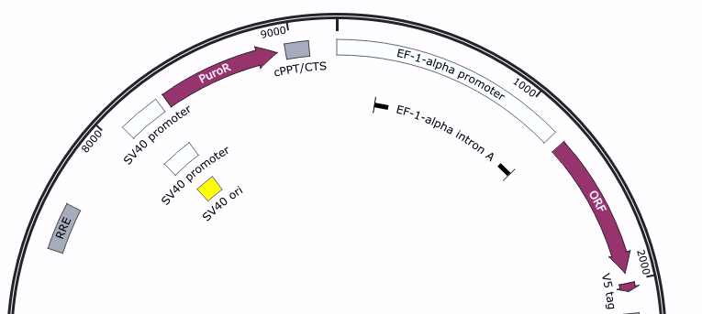
Cellular Conversion Through Ectopic TF Expression
Potential TF list selection
Cellular conversion
pLX317_ORF
Notes:
After the TF selection we set up all TFs in 2 different viral vectors to insure similarity among TFs. As a proof of concept

Slide 20
Multifaced exploratory assays
Morphological screening
Dual replicates
Potential TF list selection
Cellular conversion
Transcriptomic and epigenomic screening
RNAseq
Quadruplicate
ATACseq
Dual replicates
Notes:
After the conversion we performed different types of exploratory assays, the first one was high throughput immunostaining experiment that demonstrated a significant cellular morphology variations. And we are trying ot explore the nture of such variation using omics data so RMA sequencing which already demonstrated a significant dpcific changes for many TFs and thus implying on their important role in developmental processes, and we we’ll also add epogenomic data. Chip sew that we are currently working on and ATAC seq that we are currently processing to explain the accioacion beween expression proile to deterministic phenotype. And as you can see, we have a large data set that consist of more than 2000 thoused samples accros the different essays. Therfore we riaked in introducing technical noisiness in our sysem. There

Slide 21
Multifaced exploratory assays
Morphological screening
Dual replicates
Potential TF list selection
Cellular conversion
Transcriptomic and epigenomic screening
RNAseq
Quadruplicate
ATACseq
Dual replicates
Notes:
After the conversion we performed different types of exploratory assays, the first one was high throughput immunostaining experiment that demonstrated a significant cellular morphology variations. And we are trying ot explore the nture of such variation using omics data so RMA sequencing which already demonstrated a significant dpcific changes for many TFs and thus implying on their important role in developmental processes, and we we’ll also add epogenomic data. Chip sew that we are currently working on and ATAC seq that we are currently processing to explain the accioacion beween expression proile to deterministic phenotype. And as you can see, we have a large data set that consist of more than 2000 thoused samples accros the different essays. Therfore we riaked in introducing technical noisiness in our sysem. There

Slide 22
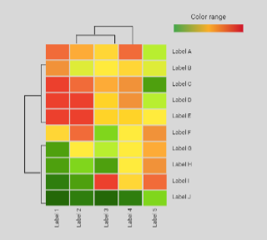
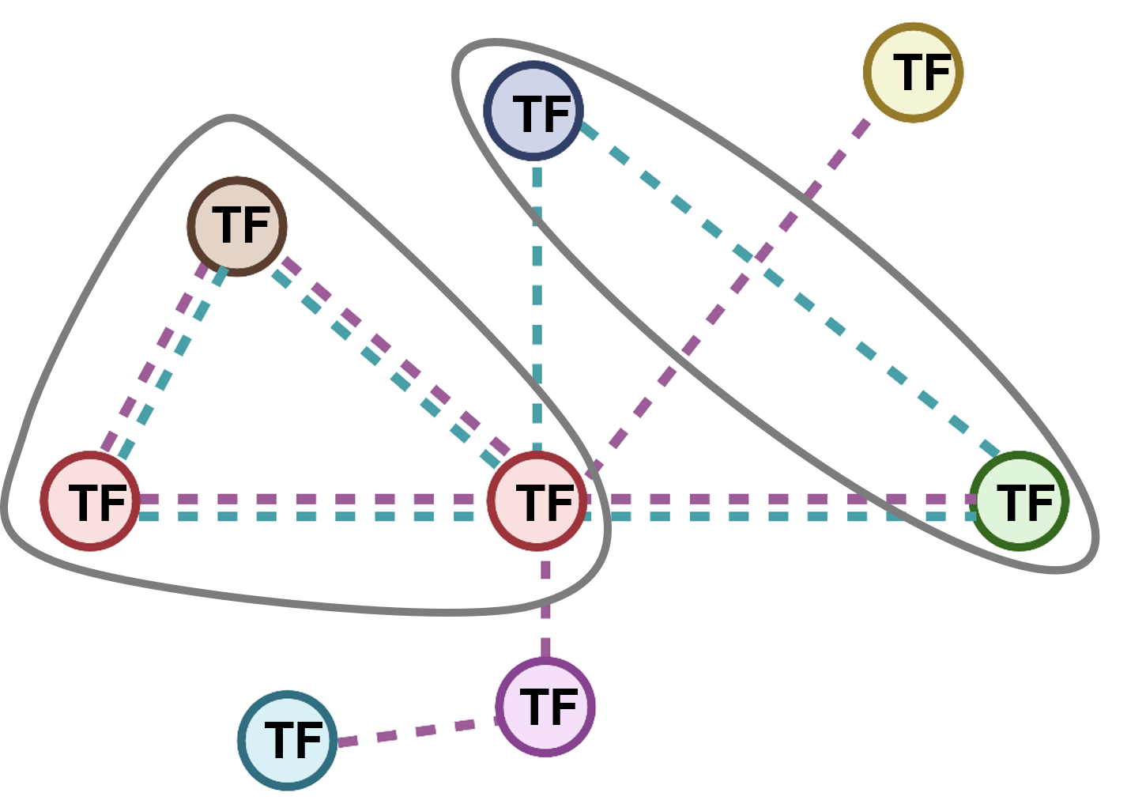
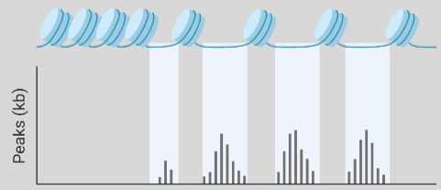
Top-level approach: Omics data
RNA-seq
Infer complete TF
interconnectivity network
ATAC-seq
Notes:
We are trying to investigate the nature of sch changes through multiomics data integration approach

Slide 23

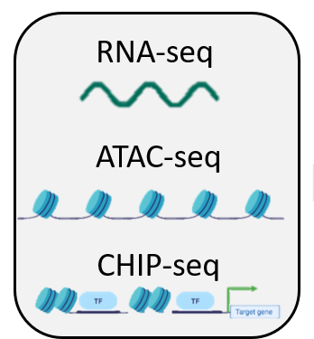
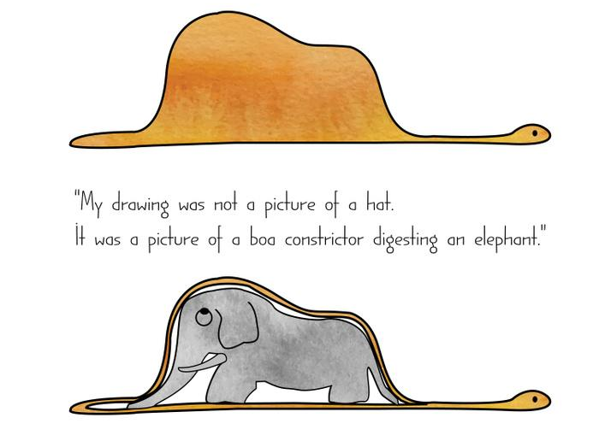
A Hat or a Snake?
Le Petit Prince
Antoine de Saint-Exupéry
Notes:
just like the little pionce asked the adults what do they see in jis drawing, and they answer a hat but actually it was sanke eating an elphen. Also in our case where we have a highlye complex data , consisting of more than 2000 samples across 4 different assays, we would like to try and unrevel the real picture hidden, the little elephant underneneeth the complexcity layrs

Slide 24
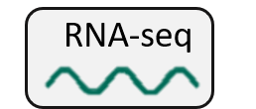
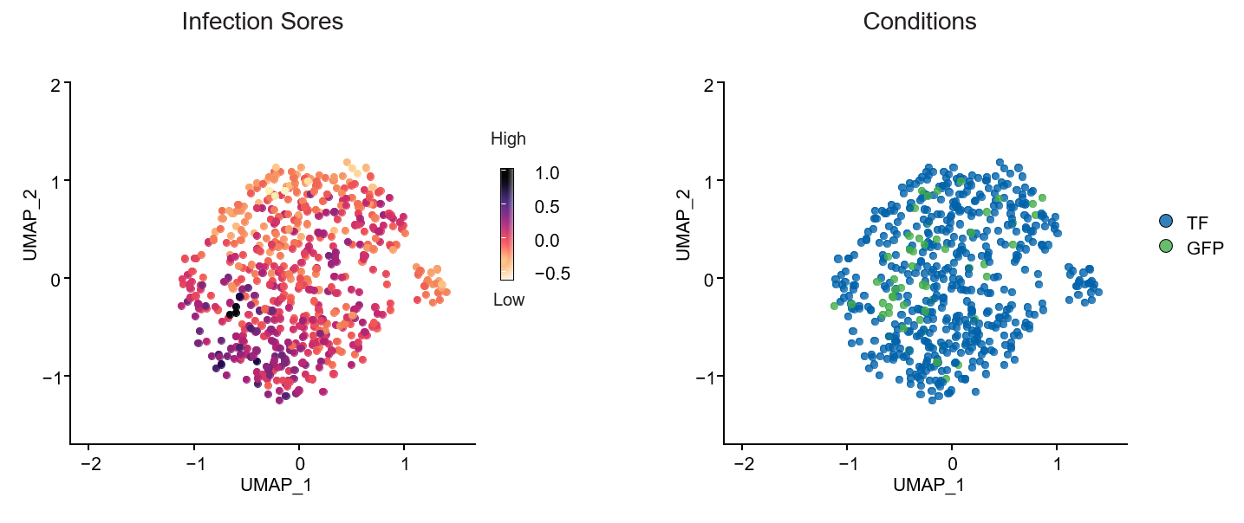
Infection-Inherited Variability Introduces Technical Noise
The directional effect of infection inherited variability likely to introduce a technical bias in downstream analysis
Notes:
So we first started analyzing the Rna seq were we have more than 1000 bulk RNA samples. And as it a sparse matrix we decided to treat it with single cell like megerments. What you see here is a umap – anon linear dim reduction where each point represent the gene expression of a single samples. First to understand the structure of our data we colored the samples by condition type.

Slide 25
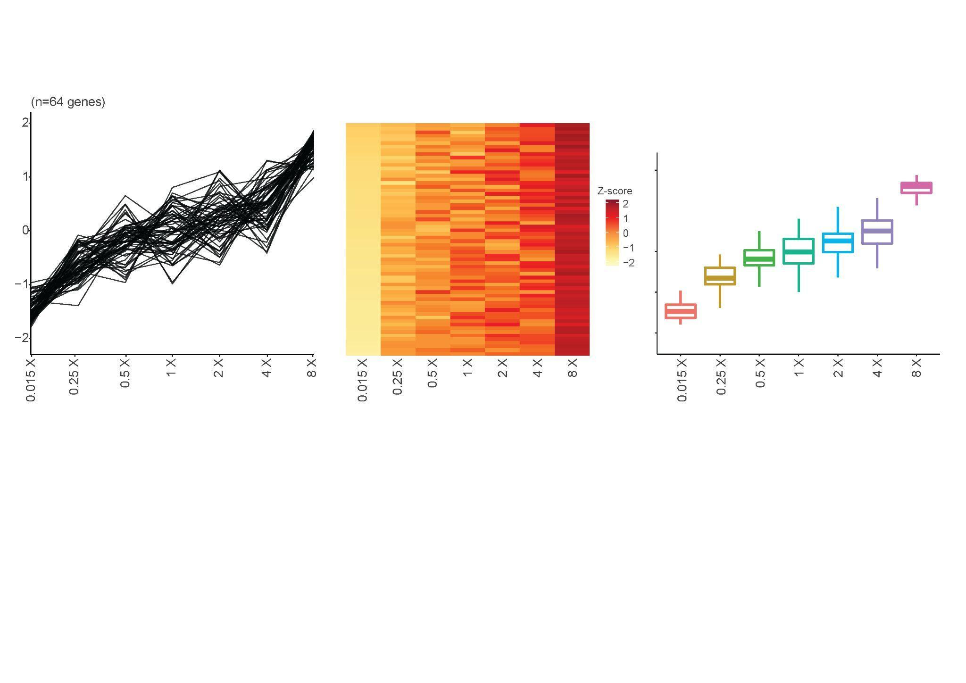
Model the Noise Structure in Our Expression Data
Expression level
MOI constrains

Slide 26
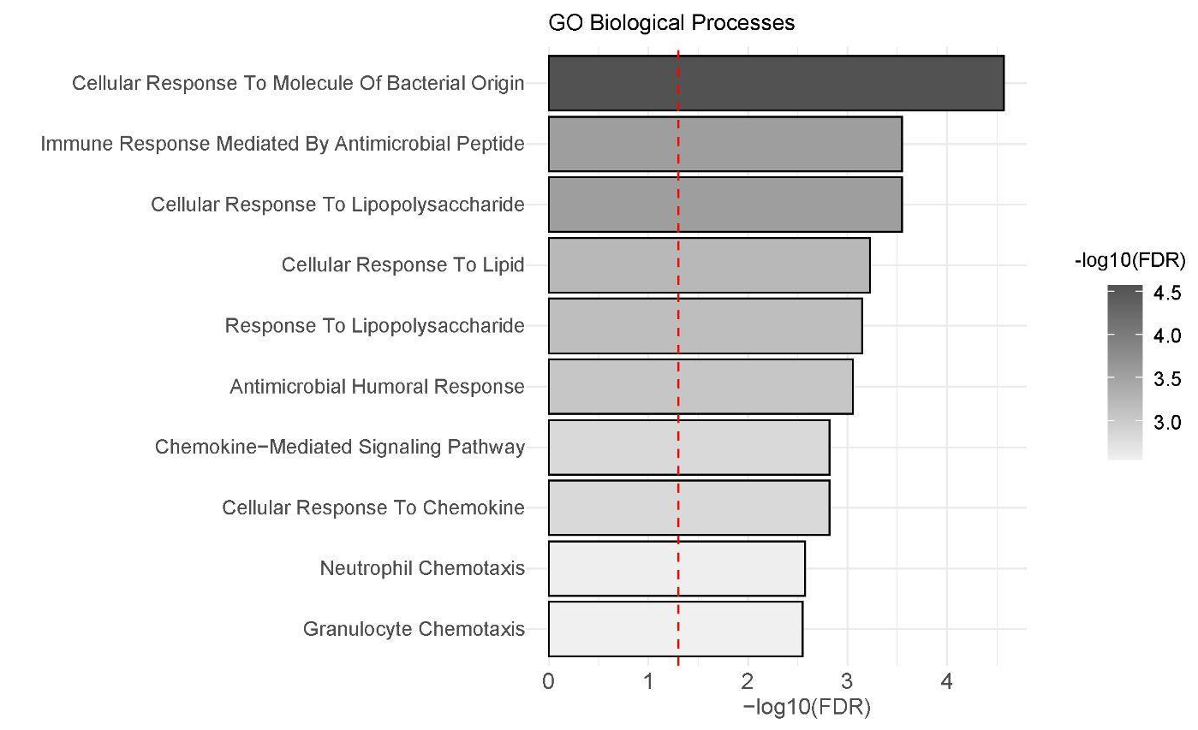
Model the Noise Structure in Our Expression Data
Expression level
MOI constrains
These findings highlight that 64 selected genes are indeed associated with the cellular response to the infection procedure.

Slide 27
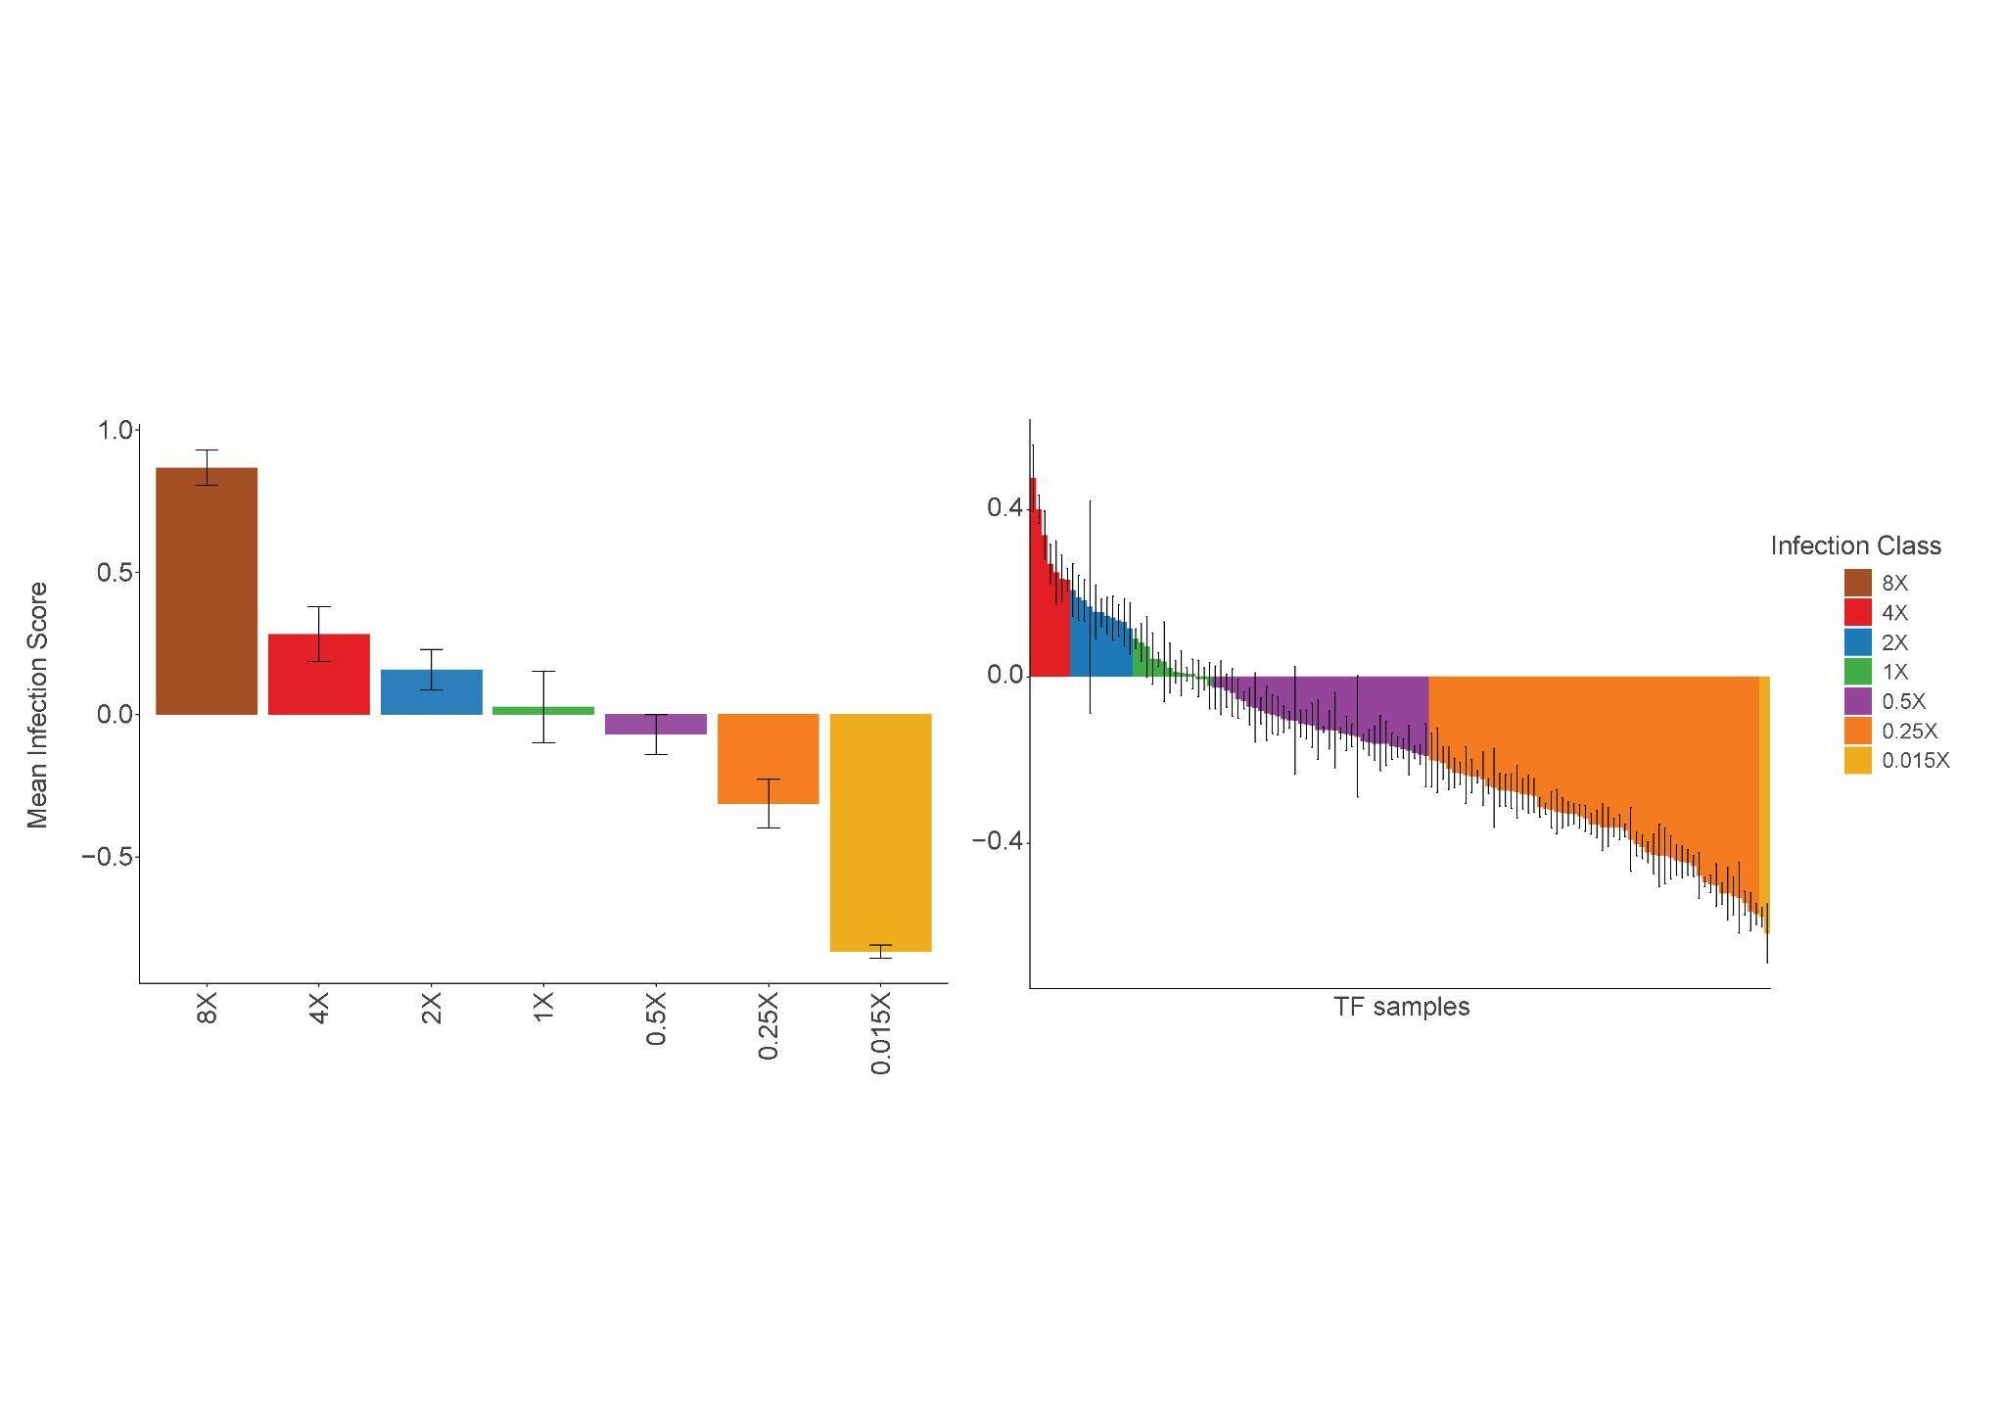
Stratification of Infection Scores for
Differential Expression Analysis
TF categorization into designated MOI concentration groups
Notes:
So we first started analyzing the Rna seq were we have more than 1000 samples. We noticed that our data is
A umap is a latent variable model The umap project the data on to axis that catche the maximum variance in the data, and therefor the closest my samples are to each other (the dot)
The similar they are on the accros the captured variations .

Slide 28
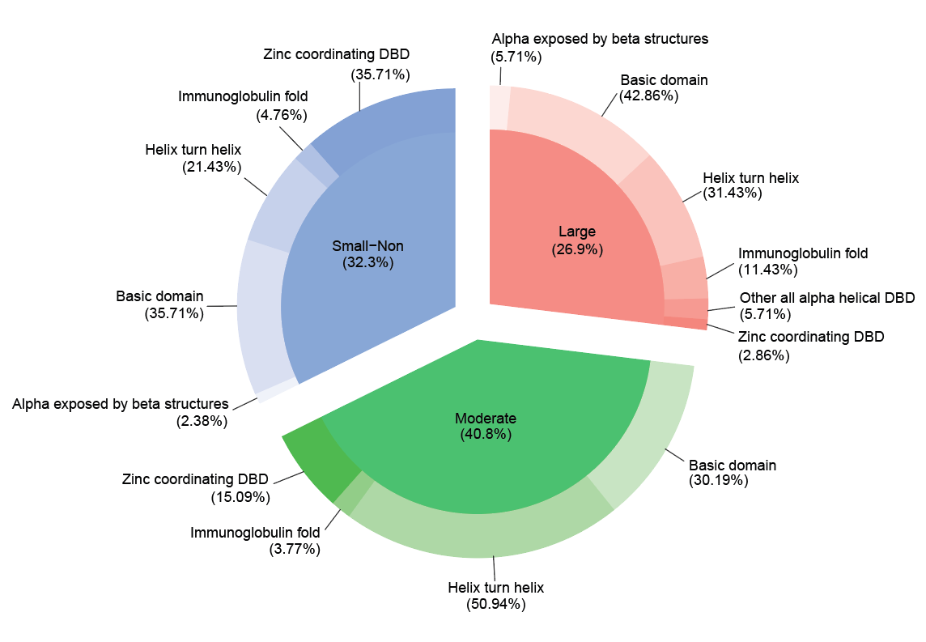
The Majority of TFs Induce Profound Transcriptional Changes
This underscoring the potential capacity of these TFs in regulating cellular fate at the transcriptional level
Notes:
So we first started analyzing the Rna seq were we have more than 1000 samples. We noticed that our data is
A umap is a latent variable model The umap project the data on to axis that catche the maximum variance in the data, and therefor the closest my samples are to each other (the dot)
The similar they are on the accros the captured variations .

Slide 29
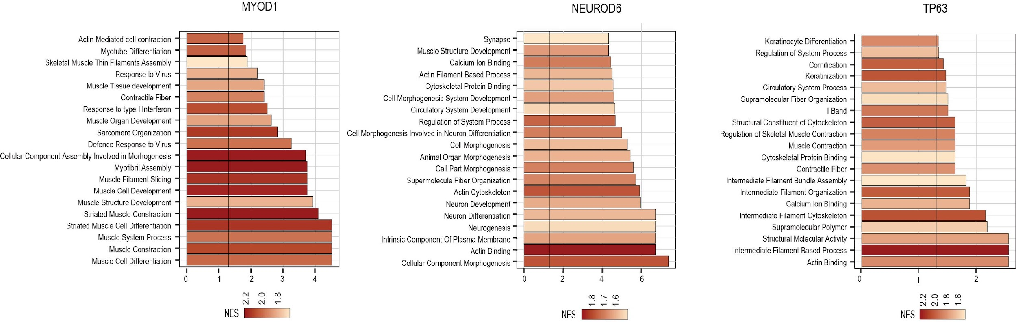
Key TFs Demonstrating Consistent Gene Signature
with Published Literature
These findings emphasis the competence of the resultant RNAseq data
Notes:
So we first started analyzing the Rna seq were we have more than 1000 samples. We noticed that our data is
A umap is a latent variable model The umap project the data on to axis that catche the maximum variance in the data, and therefor the closest my samples are to each other (the dot)
The similar they are on the accros the captured variations .

Slide 30
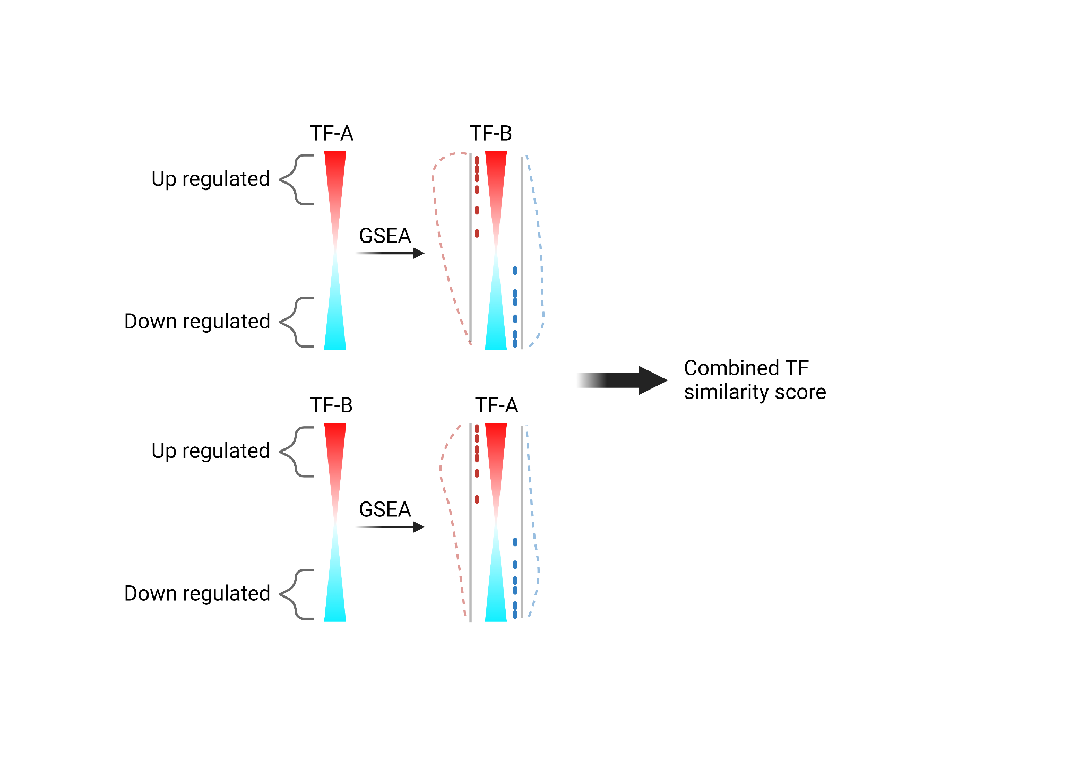
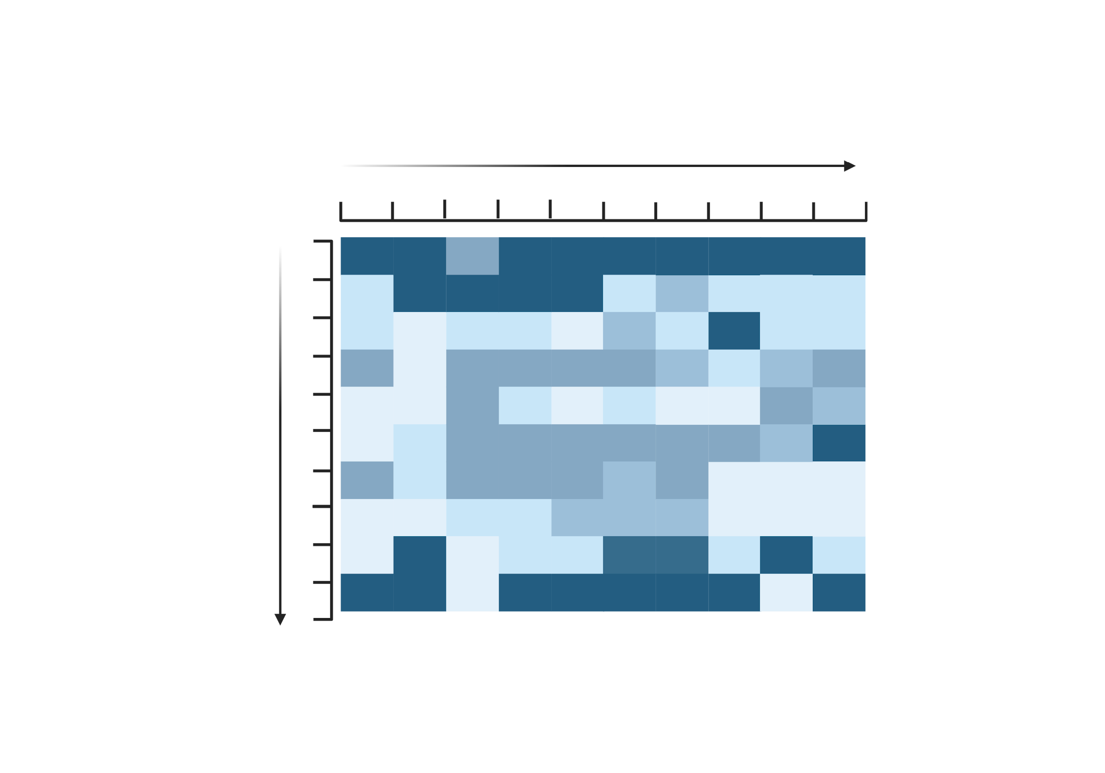
Cross-Enrichment Analysis of TFs’ Target Genes
TFs and CTR
Motifs
Notes:
So we first started analyzing the Rna seq were we have more than 1000 samples. We noticed that our data is
A umap is a latent variable model The umap project the data on to axis that catche the maximum variance in the data, and therefor the closest my samples are to each other (the dot)
The similar they are on the accros the captured variations .

Slide 31
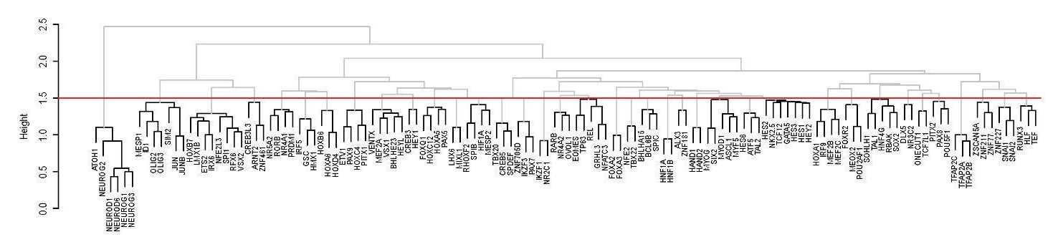
Cross-Enrichment Analysis of TFs’ Target Genes
TFs and CTR
Motifs
Notes:
So we first started analyzing the Rna seq were we have more than 1000 samples. We noticed that our data is
A umap is a latent variable model The umap project the data on to axis that catche the maximum variance in the data, and therefor the closest my samples are to each other (the dot)
The similar they are on the accros the captured variations .

Slide 32

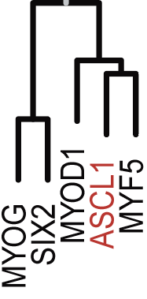

Cross-Enrichment Unveiled Co-functional and Familial Groupings Alongside Unexpected TFs Interconnections
The dendrogram shows that TFs sharing co-functional activities and those belonging to the same family tend to group closely together. Additionally, it underscores unexpected TFs interconnections.
Notes:
Cross-Enrichment reavles that TFs sharing co-functional activities and those belonging to the same family tend to group closely together. Additionally, it underscores unexpected TFs interconnections.

Slide 33
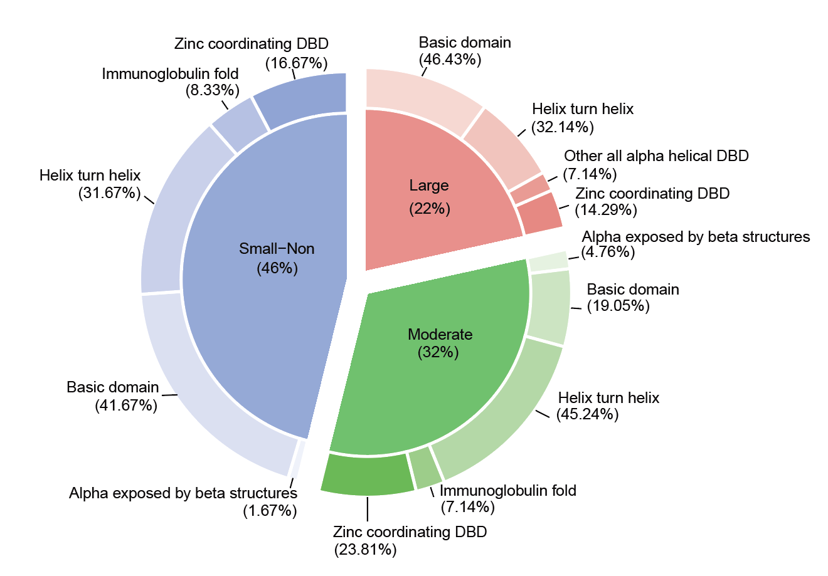
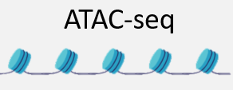
The Majority of TFs Exhibit Moderate to Large Impacts on Chromatin Accessibility
This underscoring the potential capacity of these TFs in regulating cellular fate at the through chromatin accessibility
Notes:
So we first started analyzing the Rna seq were we have more than 1000 samples. We noticed that our data is
A umap is a latent variable model The umap project the data on to axis that catche the maximum variance in the data, and therefor the closest my samples are to each other (the dot)
The similar they are on the accros the captured variations .

Slide 34
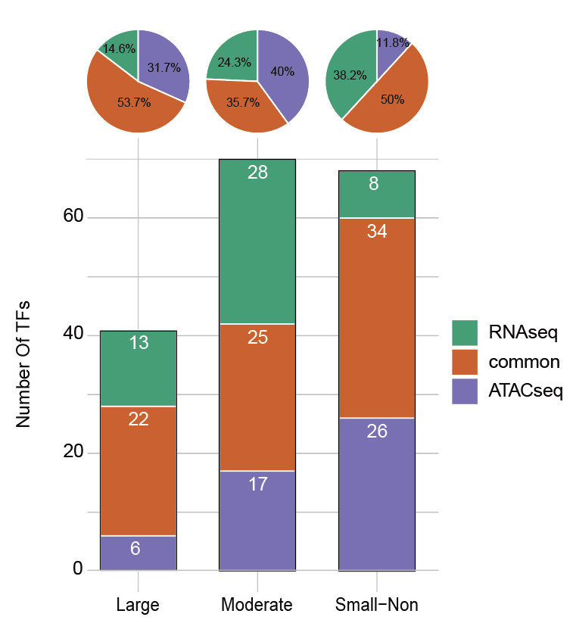
Partial Consistency of Transcription Factors Effects on Transcriptional and Epigenetic Mechanisms
This observation suggests that TFs not only vary in their efficiency to alter cellular state but also demonstrate distinct capacities in regulating transcriptional and epigenetic mechanisms
Notes:
So we first started analyzing the Rna seq were we have more than 1000 samples. We noticed that our data is
A umap is a latent variable model The umap project the data on to axis that catche the maximum variance in the data, and therefor the closest my samples are to each other (the dot)
The similar they are on the accros the captured variations .

Slide 35
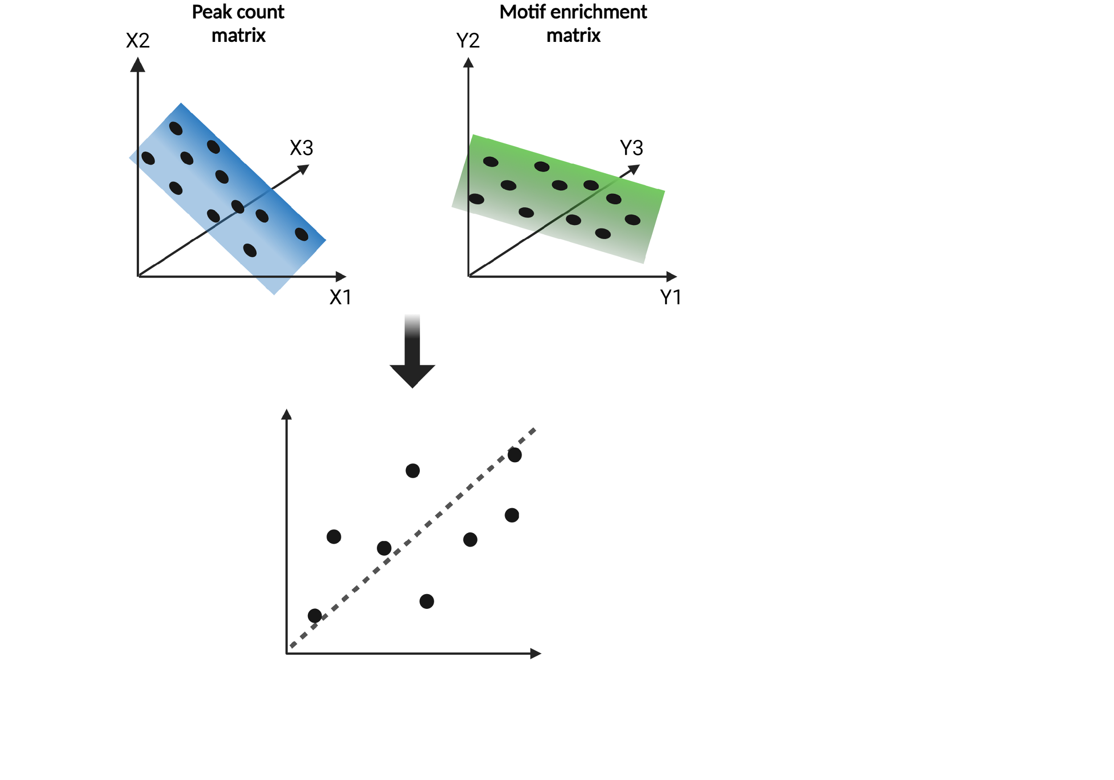
Differential Motif Enrichment Analysis
Differential Motif Enrichment Score
Δβ1_{Motif}= β1_{TF} - β1_{​GFP-control}
y=β0​+β1​x
y = peak count
​x = motif enrichment
β0 = baseline level of the peak count
when there is no motif enrichment.
​β1 = connection between TFs impact on OCRs and the motif enrichment
Notes:
In this project, we propose for the first time an unbiased screening of ~300 different TFs potentially involved in developmental processes through a high-throughput multifaceted integrative genomic approach. This will ultimately lead to new paradigms in deciphering crucial dynamics that drive cell fate decisions and thus allow us to unlock the full potential of the TF repertoire.

Slide 36
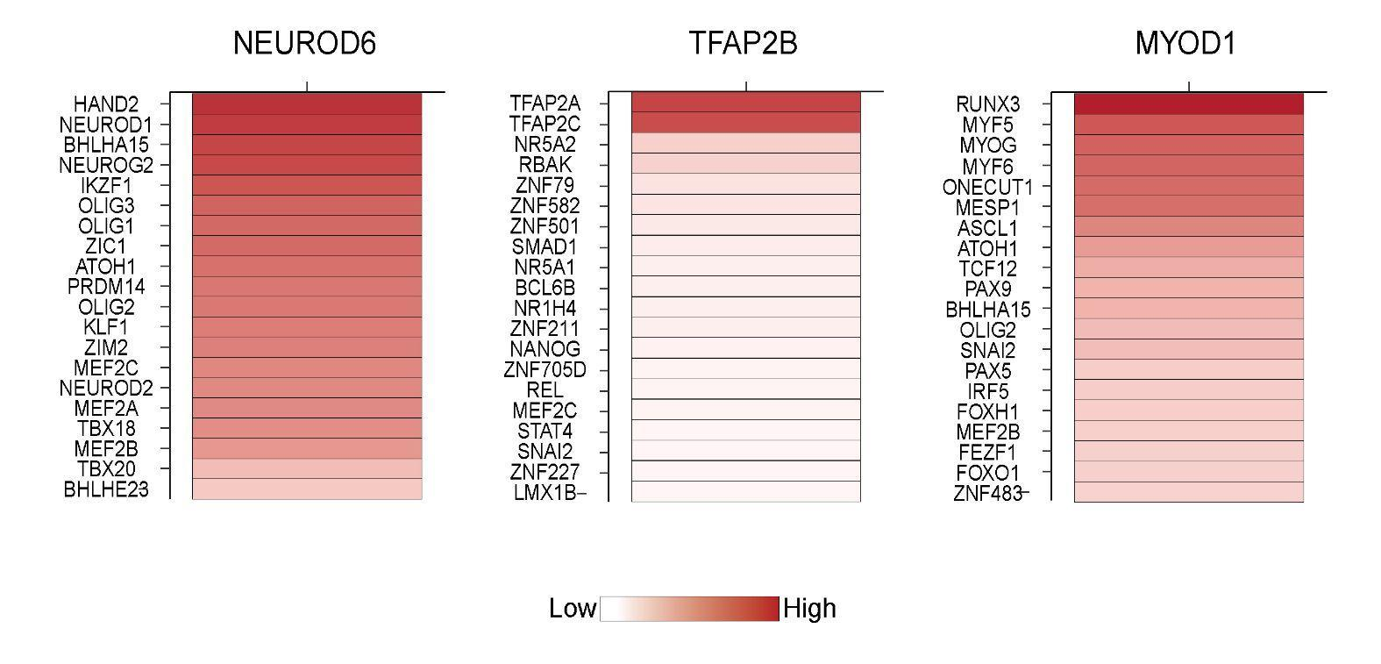
Key Transcription Factors Demonstrating Expected Motif Enrichment and Beyond their Anticipated Scope
Motif score
Notes:
In this project, we propose for the first time an unbiased screening of ~300 different TFs potentially involved in developmental processes through a high-throughput multifaceted integrative genomic approach. This will ultimately lead to new paradigms in deciphering crucial dynamics that drive cell fate decisions and thus allow us to unlock the full potential of the TF repertoire.

Slide 37
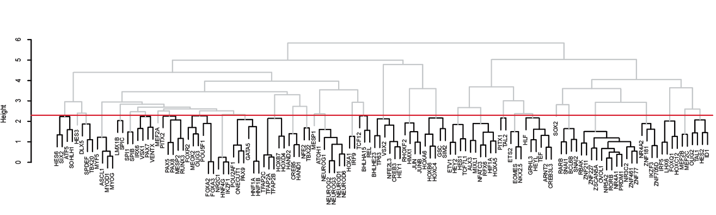
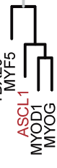


Key Transcription Factors Demonstrating Expected Motif Enrichment and Beyond their Anticipated Scope
The dendrogram shows that TFs sharing co-functional activities and those belonging to the same family tend to group closely together. Additionally, it underscores unexpected TFs interconnections.
Notes:
In this project, we propose for the first time an unbiased screening of ~300 different TFs potentially involved in developmental processes through a high-throughput multifaceted integrative genomic approach. This will ultimately lead to new paradigms in deciphering crucial dynamics that drive cell fate decisions and thus allow us to unlock the full potential of the TF repertoire.

Slide 38
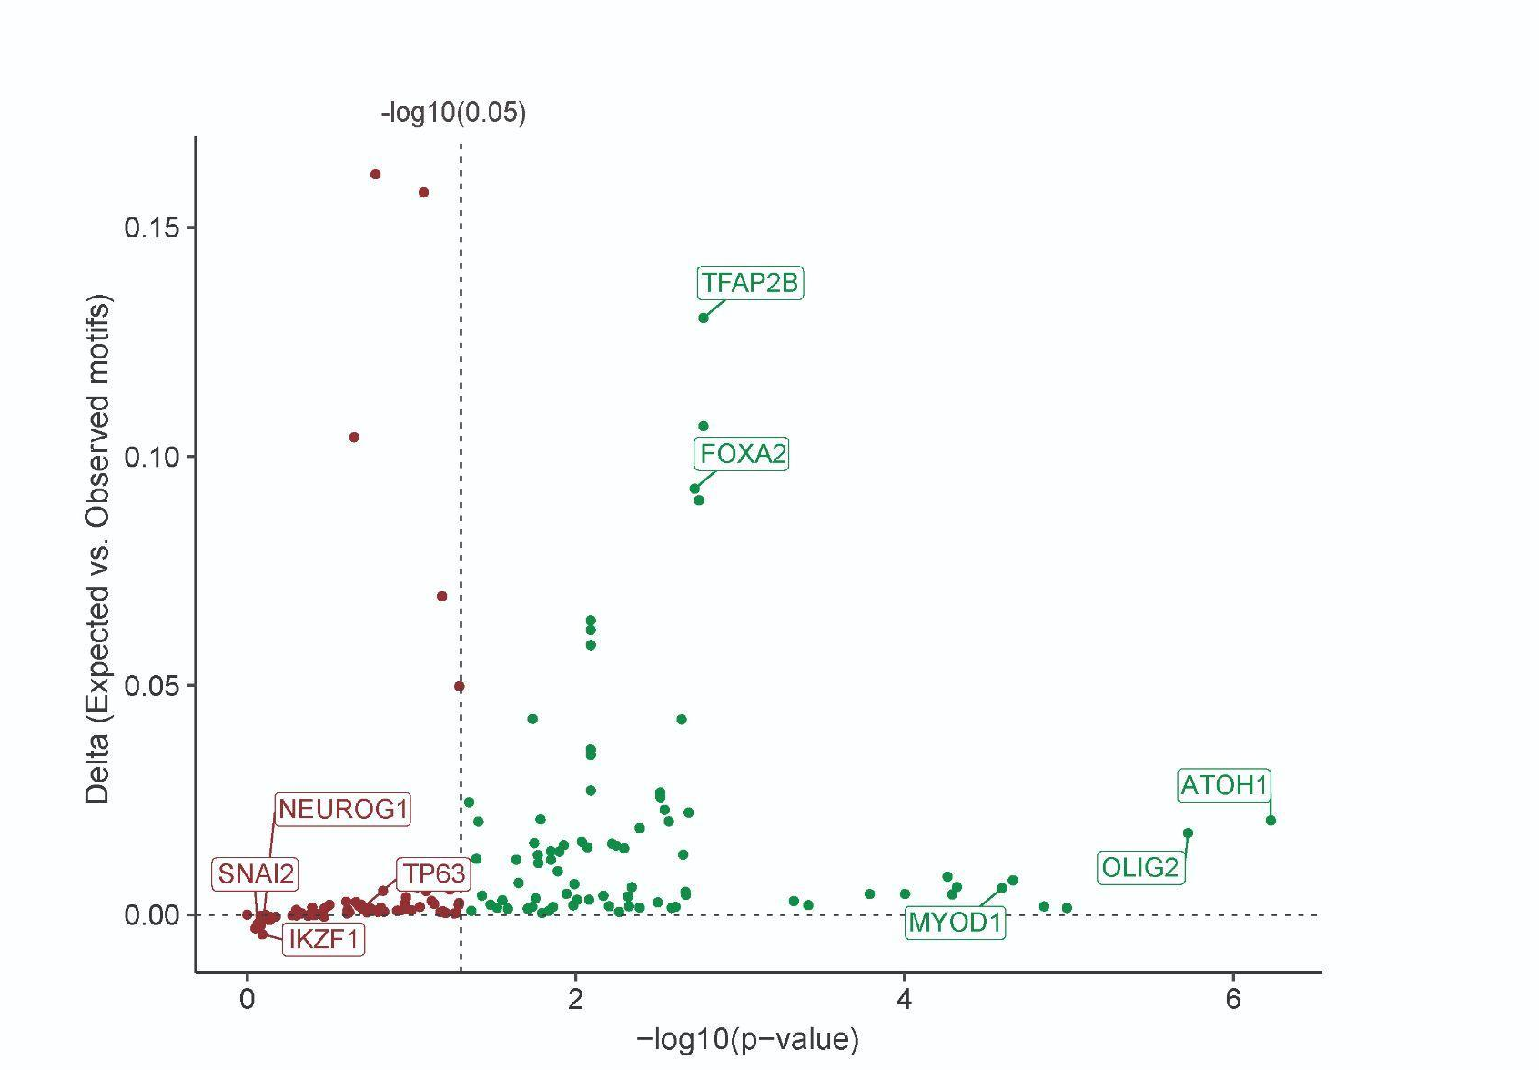
Motif Reshape Analysis to Highlight Transcription Factors with Greater Potential to Act as Chromatin Remodelers
S= Δβ1_{​expected} -Δβ1_{observed}
Notes:
In this project, we propose for the first time an unbiased screening of ~300 different TFs potentially involved in developmental processes through a high-throughput multifaceted integrative genomic approach. This will ultimately lead to new paradigms in deciphering crucial dynamics that drive cell fate decisions and thus allow us to unlock the full potential of the TF repertoire.

Slide 39
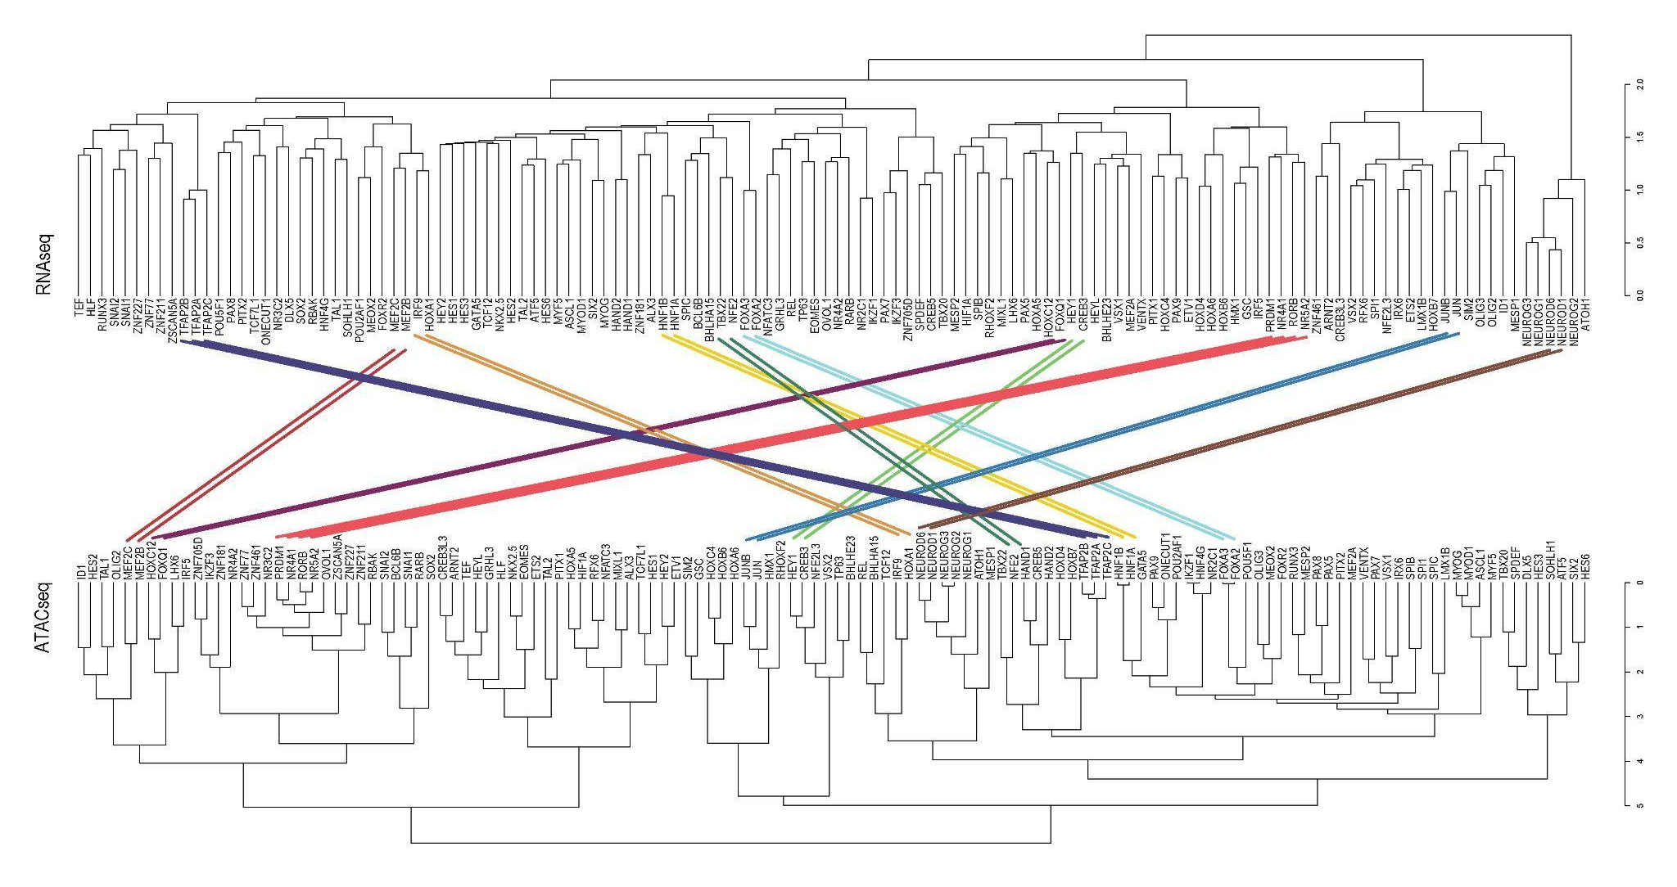
Clustering Results from ATACseq and RNAseq Analyses are Not Statistically Similar
RNAseq
ATACseq
The results imply that the TF-induced regulatory landscapes, as captured by ATACseq and RNAseq represent different aspects of regulatory mechanisms. Yet, uncharacterized TF interactions were consistently observed at both levels
Notes:
In this project, we propose for the first time an unbiased screening of ~300 different TFs potentially involved in developmental processes through a high-throughput multifaceted integrative genomic approach. This will ultimately lead to new paradigms in deciphering crucial dynamics that drive cell fate decisions and thus allow us to unlock the full potential of the TF repertoire.

Slide 40
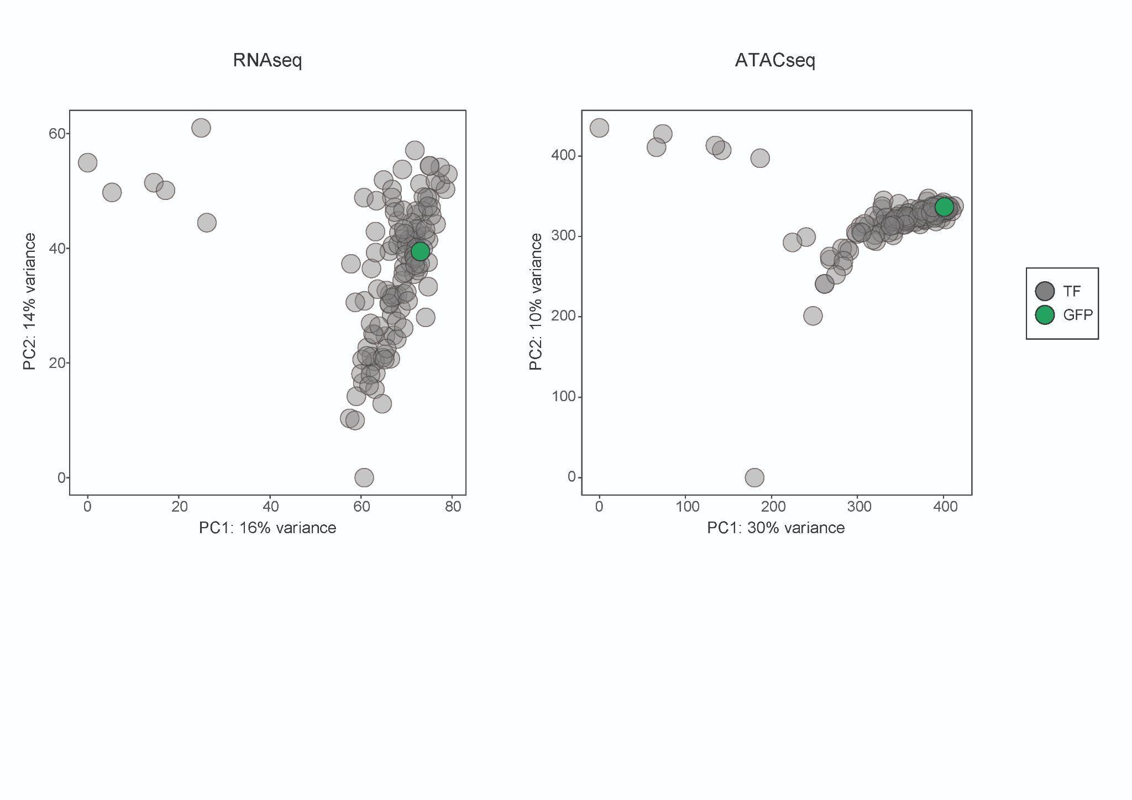
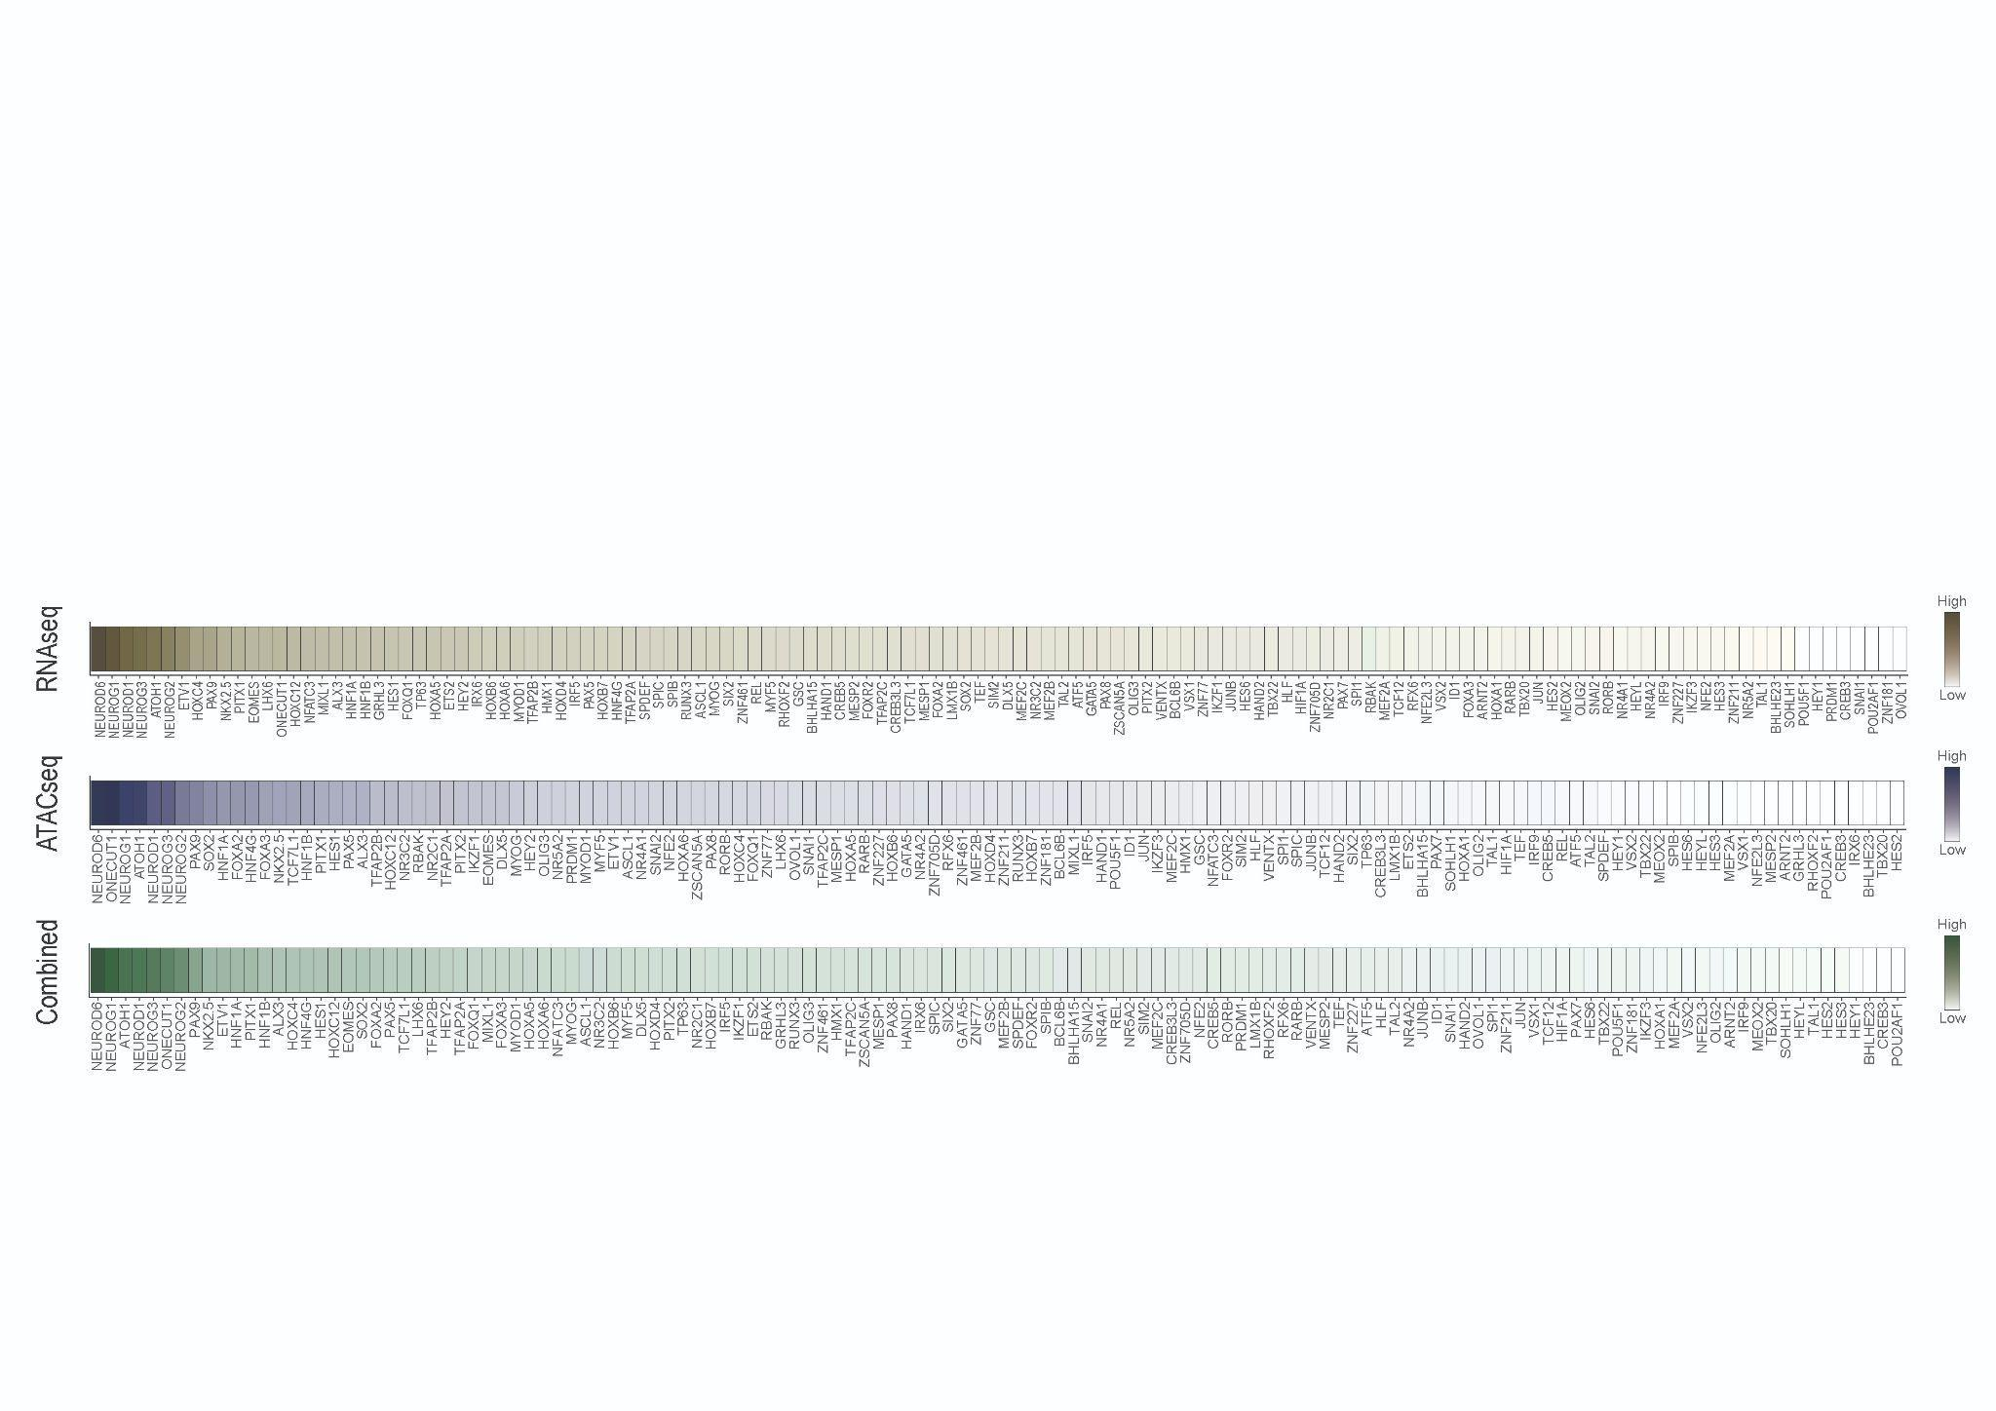
Integrated TF Activity Scores at Transcriptional and Epigenetic Levels
RNAseq
ATACseq
Notes:
In this project, we propose for the first time an unbiased screening of ~300 different TFs potentially involved in developmental processes through a high-throughput multifaceted integrative genomic approach. This will ultimately lead to new paradigms in deciphering crucial dynamics that drive cell fate decisions and thus allow us to unlock the full potential of the TF repertoire.

Slide 41
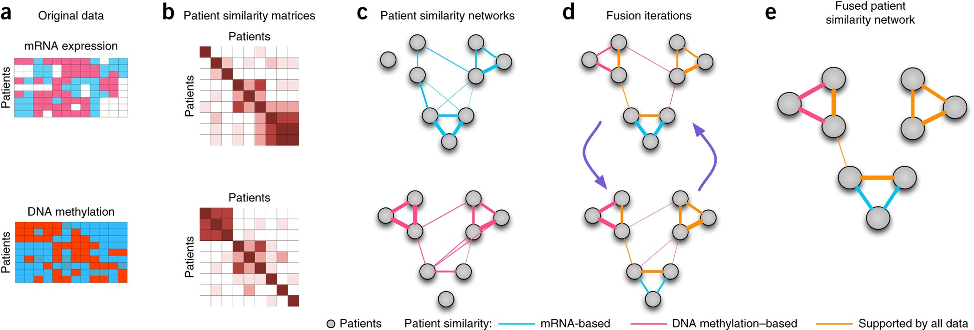
Similarity Network Fusion as Multiomic Integration Tool
RNAseq
ATACseq
Wang, B., Mezlini, A., Demir, F. et al. Similarity network fusion for aggregating data types on a genomic scale. Nat Methods (2014).
By utilizing multiomic data, we adjusted the SNF computational method to prioritize TFs not based on raw reads but relaying on their predominant effect on gene expression and chromatin accessibility
Notes:
In this project, we propose for the first time an unbiased screening of ~300 different TFs potentially involved in developmental processes through a high-throughput multifaceted integrative genomic approach. This will ultimately lead to new paradigms in deciphering crucial dynamics that drive cell fate decisions and thus allow us to unlock the full potential of the TF repertoire.

Slide 42
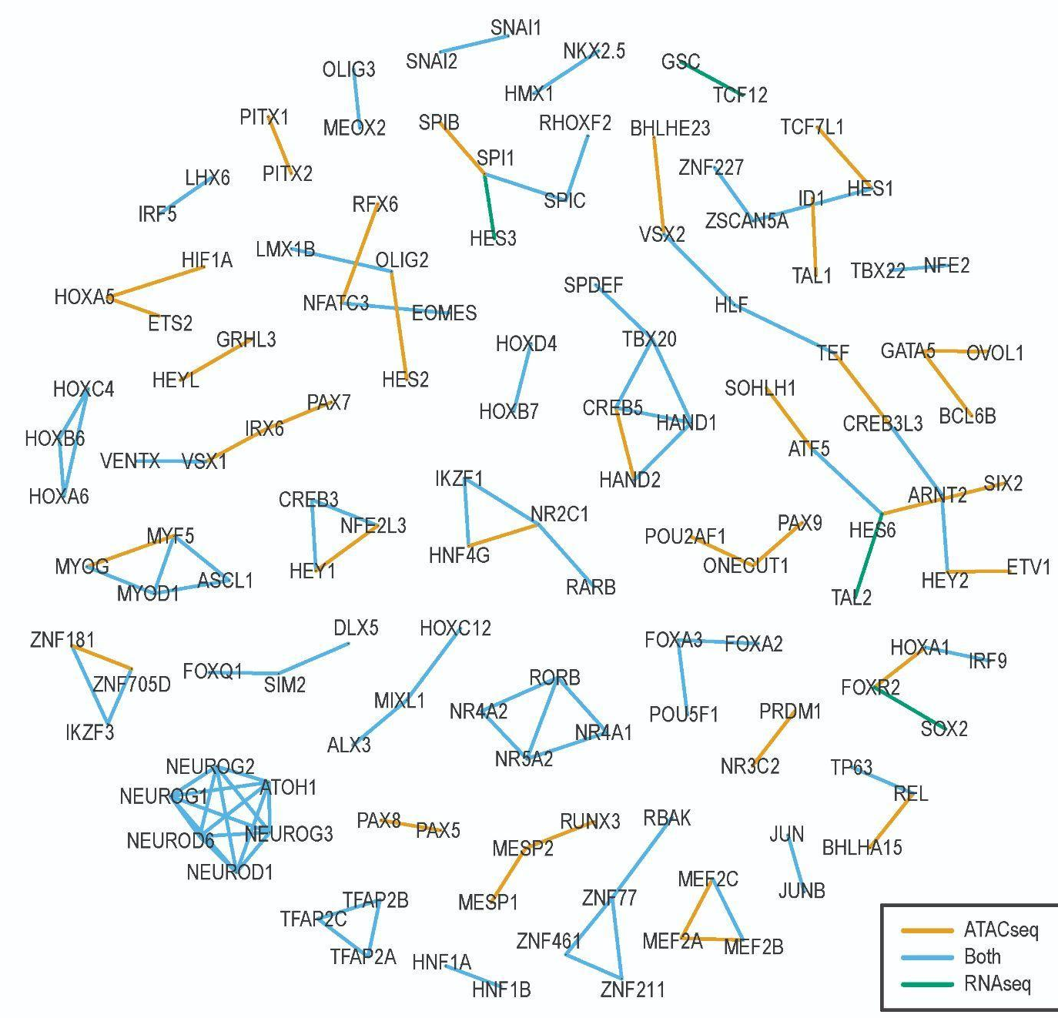
Integrated Connectivity Network Demonstrating Known and Uncharacterized Transcription Factors Modules
RNAseq
ATACseq
The results obtained allowed us to generate several critical biological observations.
We showed that TFs are grouped in closer clusters when they induce similar signatures, either transcriptional (green lines), epigenetic (yellow), or both (blue).
Many TFs belonging to the same family, induced the same transcriptional and epigenetic
TFs were closely grouped into a single module by exerting similar biological functions, such as cardiac
We identified unexpected connections of TFs that were closely grouped within modules of known co-regulator TFs
Notes:
In this project, we propose for the first time an unbiased screening of ~300 different TFs potentially involved in developmental processes through a high-throughput multifaceted integrative genomic approach. This will ultimately lead to new paradigms in deciphering crucial dynamics that drive cell fate decisions and thus allow us to unlock the full potential of the TF repertoire.

Slide 43
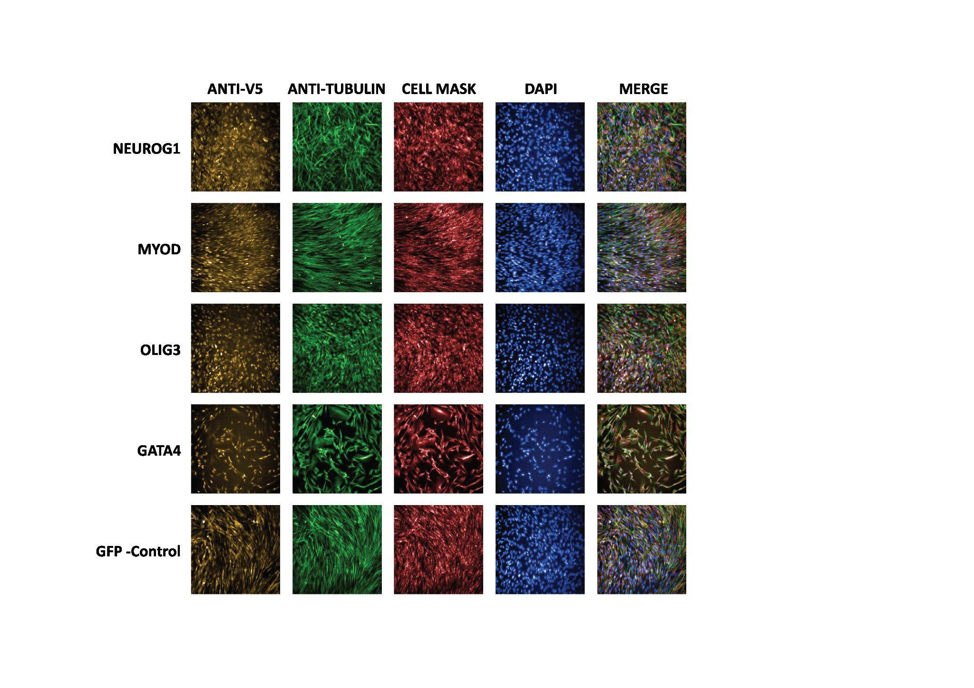
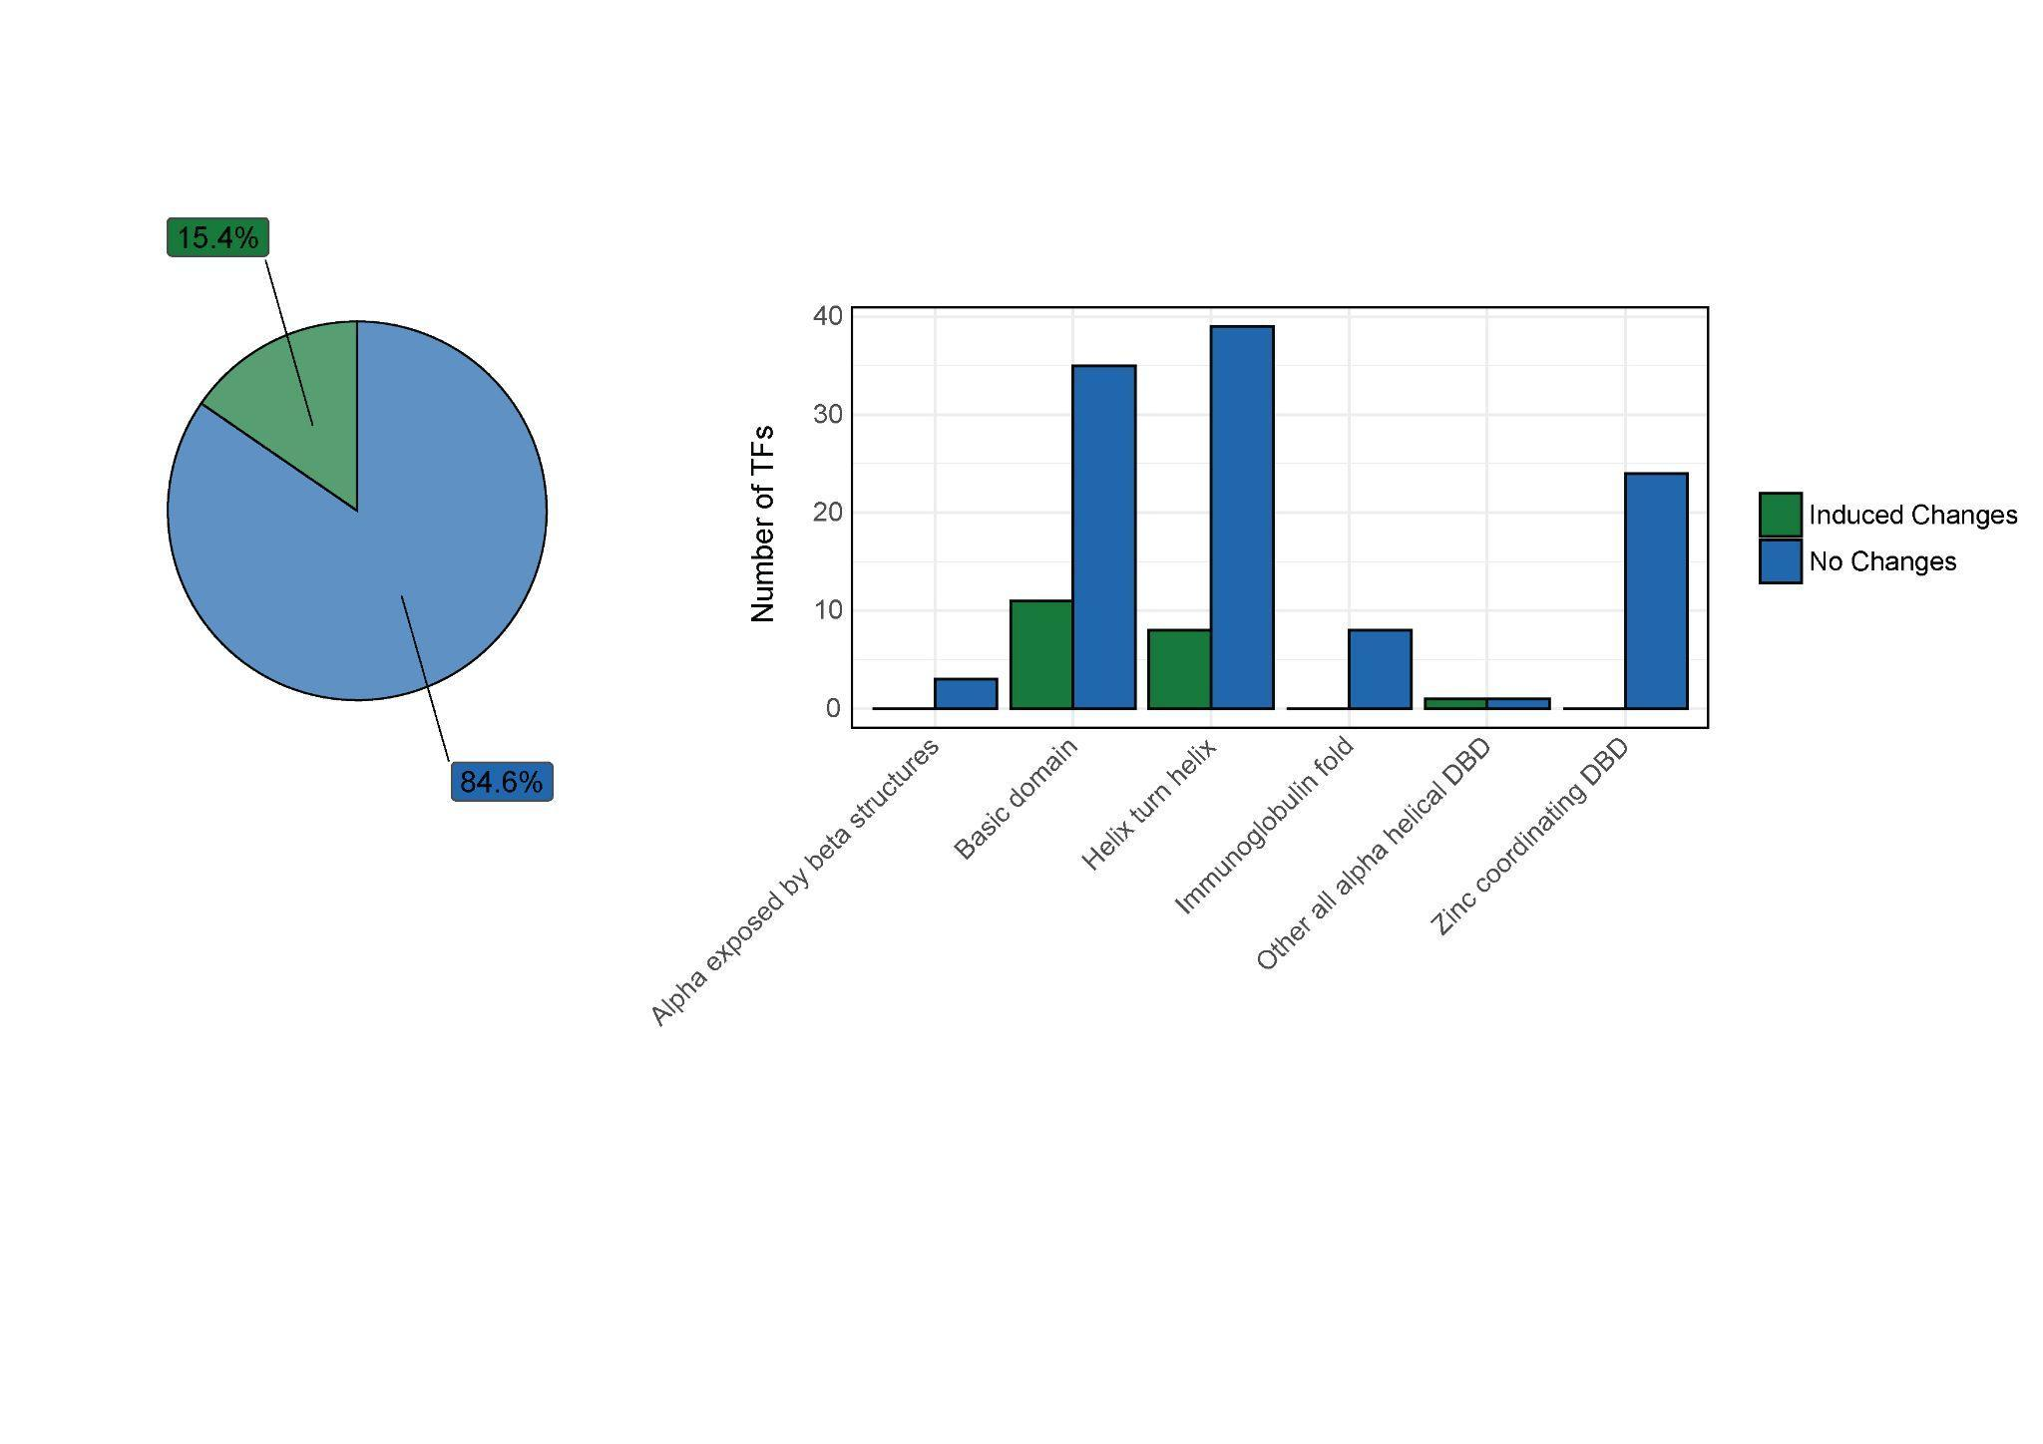
A High-Throughput Immunofluorescence Assay to Capture Induced Morphological Changes
The findings highlight a discrepancy between incomplete cellular phenolic levels and significant transcriptional changes induced by TFs, suggesting that more complex mechanisms may be involved in regulating phenolic biosynthesis.
*Lorenzo Vacaro

Slide 44
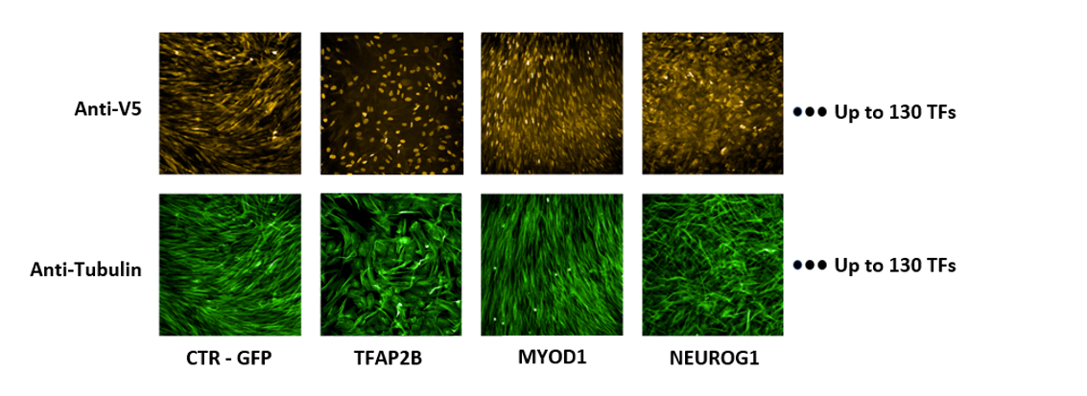
TF specific cellular morphology changes

Slide 45
Outline
First Project: An Integrated Screening to Infer Transcription Factor Regulatory Networks Governing Cell Fate Decisions
Introduction
Results
Summary and Insights
Second Project: Spatial Transcriptomics Reveals Sub-Tumoral Identities and Novel Diagnostic Markers in Triple Negative Breast Cancer with Immune Evasion Capacity
Introduction
Results
Summary and Insights
Notes:
So ill fist strat with a short background on the state of the arts and current challenges in the filed

Slide 46
Summary and Insights
First Project: An Integrated Screening to Infer Transcription Factor Regulatory Networks Governing Cell Fate Decisions
Our approach represents one, if not the only, case of side-by-side comparison of TF dosages within the same experimental setting.
Addressed limitations of previous studies by accounting for pre-existing epigenetic states, offering insights more applicable to in vitro cellular conversion processes without promoting specific cellular fates.
Results
Developed novel computational methods to extract crucial biological context from omics data, moving beyond primary information to highlight TF interconnectivity.
Successfully distinguished paralog genes from those maintaining identical biological functions, demonstrating the effectiveness of the screening approach for characterizing TF functionalities and uncovering novel interconnections.
Notes:
So ill fist strat with a short background on the state of the arts and current challenges in the filed

Slide 47
Prospective
First Project: An Integrated Screening to Infer Transcription Factor Regulatory Networks Governing Cell Fate Decisions
Completing the exploratory phase across all 277 selected TFs.
Complete the analyses the morphological changes to provide additional impetus to precise the concluded multiomic TF connectivity network.
Complete TF combinatorial assays to improve cellular reprogramming in vitro toward a myogenic and cardiac fate.
Successfully distinguished paralog genes from those maintaining identical biological functions, demonstrating the effectiveness of the screening approach for characterizing TF functionalities and uncovering novel interconnections.
Notes:
So ill fist strat with a short background on the state of the arts and current challenges in the filed

Slide 48
Outline
First Project: An Integrated Screening to Infer Transcription Factor Regulatory Networks Governing Cell Fate Decisions
Introduction
Results
Summary and Insights
Second Project: Spatial Transcriptomics Reveals Sub-Tumoral Identities and Novel Diagnostic Markers in Triple Negative Breast Cancer with Immune Evasion Capacity
Introduction
Results
Summary and Insights
Notes:
Similarly to the structure of my thesis, I will present each introduction, results and summary and insights, starting from the first project

Slide 49
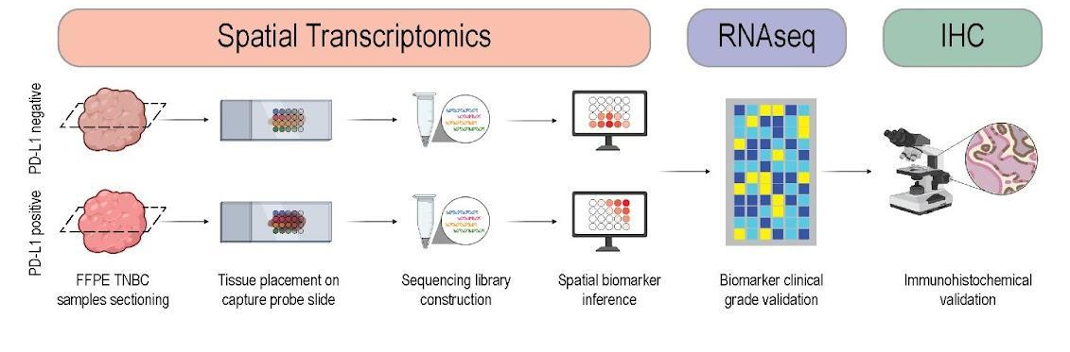
Outline
Second Project: Spatial Transcriptomics Reveals Sub-Tumoral Identities and Novel Diagnostic Markers in Triple Negative Breast Cancer with Immune Evasion Capacity
In this study, we developed a cost-effective clinical workflow combining spatial transcriptomics, clinical-grade RNAseq, and IHC to analyze TNBC at a spatial level focusing on PD-L1 status. This allowed us to explore sub-tumoral variations, understand tumor-microenvironment interactions, and identify LY6D as a novel diagnostic marker potentially complementing conventional PD-L1 test.
Notes:
Similarly to the structure of my thesis, I will present each introduction, results and summary and insights, starting from the first project

Slide 50
Outline
First Project: An Integrated Screening to Infer Transcription Factor Regulatory Networks Governing Cell Fate Decisions
Introduction
Results
Summary and Insights
Second Project: Spatial Transcriptomics Reveals Sub-Tumoral Identities and Novel Diagnostic Markers in Triple Negative Breast Cancer with Immune Evasion Capacity
Introduction
Results
Summary and Insights
Notes:
Similarly to the structure of my thesis, I will present each introduction, results and summary and insights, starting from the first project

Slide 51
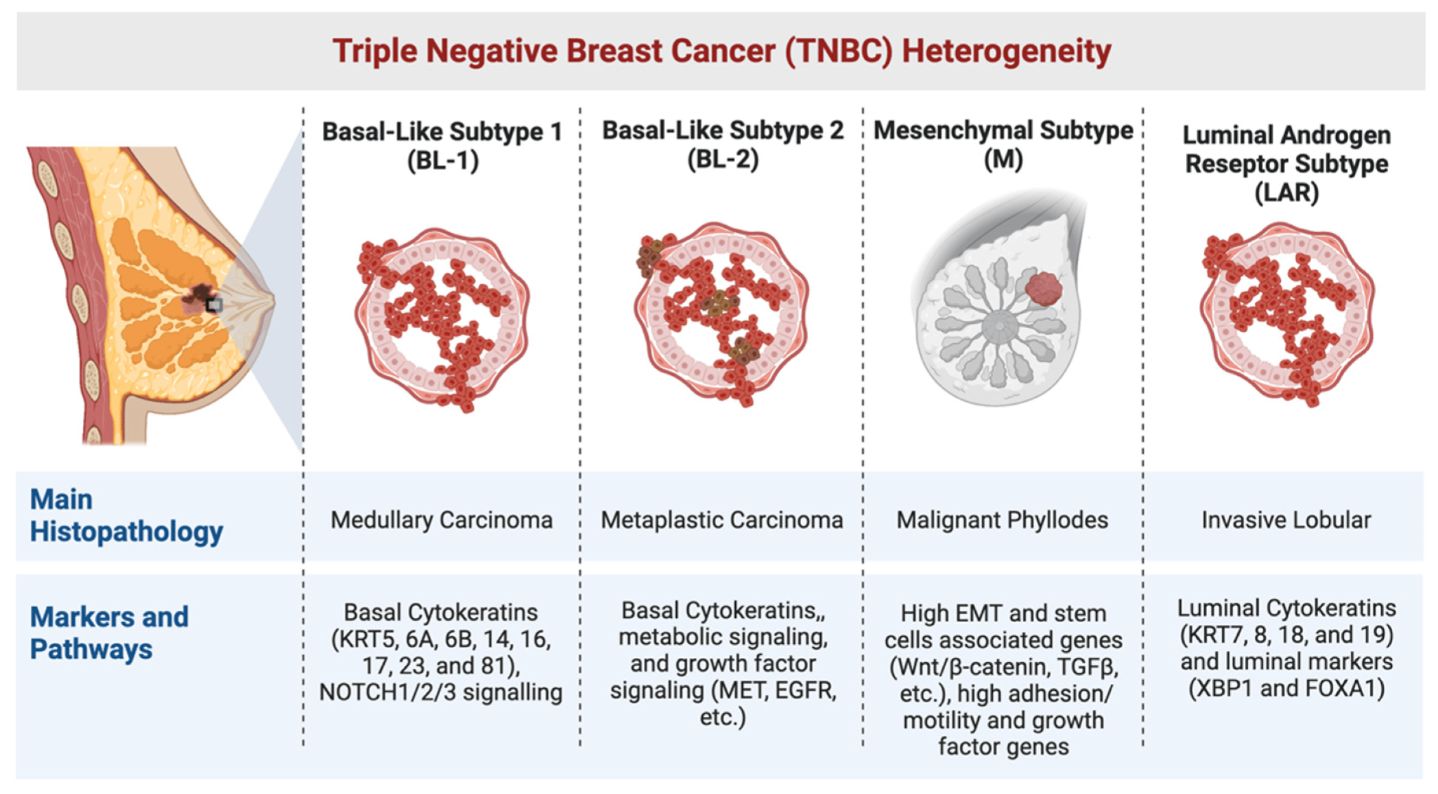
TNBC Aggressiveness and Prognosis
Poorer prognosis compared to other breast cancer subtypes
Inefficient treat due to its aggressive nature and limited responsiveness to hormonal and targeted therapies.
Exhibiting lower overall survival rates and a higher recurrence frequency
High variability in response to therapy and molecular characteristics
TNBC is an aggressive type accounted for 10% of all breast cancer diagnoses
Adapted from Mahmoud, Rinad et al. Cancers (2022)
Notes:
So ill fist strat with a short background on the state of the arts and current challenges in the filed

Slide 52
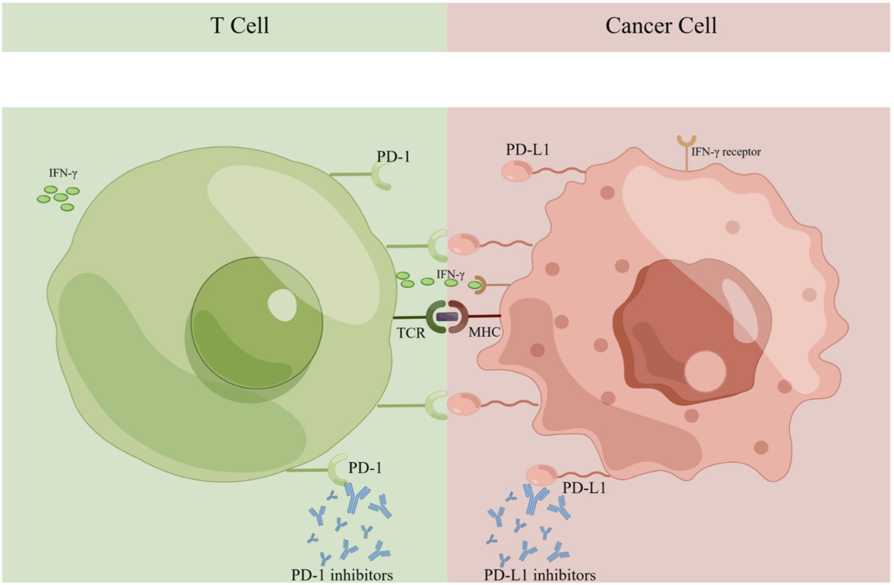
Immune Landscape and Targeted Therapies in TNBC
Targeting the PD-1/PD-L1 pathway with ICIs has been developed to disrupt this mechanism, enhancing the host anti-tumor immune response to attack cancer
Adapted from Yang, Tinglin et al., Journal of personalized medicine (2023)
FDA's approval of atezolizumab (anti-PD-L1) and pembrolizumab (anti-PD-1) combined with chemotherapy as a first-line therapy in PD-L1-positive metastatic TNBC1
Notes:
So ill fist strat with a short background on the state of the arts and current challenges in the filed

Slide 53
Immune Checkpoint Inhibitors Treatment Demonstrate Inconsistent Therapeutic Outcomes and Fluctuating ORR
Adapted from Yang, Tinglin et al., Journal of personalized medicine (2023)
However, the variability in Immunohistochemistry-based PD-L1 diagnostic tests and the wide dynamic range of PD-L1 expression levels obstruct patient selection, resulting in inconsistent therapeutic outcomes and fluctuating ORR.
Notes:
This variability emphasizes the challenges of employing PD-L1 as a reliable diagnostic marker and highlights the need for standardized clinical approaches to enhance the sensitivity and reproducibility of diagnostic tests. Establishing such a uniform framework is essential for refining patient selection and enhancing the precision of patient selection for anti-PD-1/PD-L1 therapies, consequently enabling the development of more effective treatment strategies that improve patient outcomes

Slide 54



The advent of Single-Cell RNA Sequencing Technologies has unlocked new horizons in Cancer research
Notes:
So ill fist strat with a short background on the state of the arts and current challenges in the filed

Slide 55

Spatial transcriptomics empowers gene Expression studies with
enhanced Resolution and pathological Context Preservation
Notes:
So ill fist strat with a short background on the state of the arts and current challenges in the filed

Slide 56

Spatial transcriptomics empowers gene Expression studies with
enhanced Resolution and pathological Context Preservation
Notes:
So ill fist strat with a short background on the state of the arts and current challenges in the filed

Slide 57
Outline
First Project: An Integrated Screening to Infer Transcription Factor Regulatory Networks Governing Cell Fate Decisions
Introduction
Results
Summary and Insights
Second Project: Spatial Transcriptomics Reveals Sub-Tumoral Identities and Novel Diagnostic Markers in Triple Negative Breast Cancer with Immune Evasion Capacity
Introduction
Results
Summary and Insights
Notes:
Similarly to the structure of my thesis, I will present each introduction, results and summary and insights, starting from the first project

Slide 58
Efficient and Cost-Effective Clinical Workflow to Spatially Resolve the Heterogeneous Nature of TNBC Architecture Focusing on PD-L1 status
Our workflow is specifically designed to benefit from a minimal requirement of input samples and compatibility with standard laboratory equipment
Notes:
So ill fist strat with a short background on the state of the arts and current challenges in the filed

Slide 59
Efficient and Cost-Effective Clinical Workflow to Spatially Resolve the Heterogeneous Nature of TNBC Architecture Focusing on PD-L1 status
Our workflow is specifically designed to benefit from a minimal requirement of input samples and compatibility with standard laboratory equipment
Notes:
So ill fist strat with a short background on the state of the arts and current challenges in the filed

Slide 60

Spatial Spots Assigned as Tumor Exhibit a Higher Transcriptional Activity
Notes:
So ill fist strat with a short background on the state of the arts and current challenges in the filed

Slide 61

Spatial Spots Assigned as Tumor Exhibit a Higher Transcriptional Activity
This is in line with previous research, which has documented a considerable upregulation of gene expression in cancer cells. Consequently, this reinforces the credibility and reliability of our spatial sequencing data
Notes:
So ill fist strat with a short background on the state of the arts and current challenges in the filed

Slide 62

PD-L1 Expression Analysis Demonstrate Consistency With the Initial Evaluation
The finding is consistent with previous studies indicating that PD-L1 can be expressed by either infiltrating immune cells within the microenvironment or by tumor cells
Notes:
So ill fist strat with a short background on the state of the arts and current challenges in the filed

Slide 63

Tissue Marker Genes Exhibited High Spatial Specificity for Their Corresponding Histological Annotation
Our results suggest that sequencing data can effectively preserve spatial information integrity, making it a valuable additional layer of information to complement manual pathological annotation
Notes:
So ill fist strat with a short background on the state of the arts and current challenges in the filed

Slide 64

Histological Compartment Compositions Within Each Cluster Revealed Complex Spatial Patterns
Notes:
So ill fist strat with a short background on the state of the arts and current challenges in the filed

Slide 65

Histological Compartment Compositions Within Each Cluster Revealed Complex Spatial Patterns
Notes:
So ill fist strat with a short background on the state of the arts and current challenges in the filed

Slide 66

Enrichment of Stromal and Tumor Expression Signatures Aligned with Tissue Compartments Reveals and Overlooked Histological Annotations
Reminder
Notes:
So ill fist strat with a short background on the state of the arts and current challenges in the filed

Slide 67



Reassignment of spatial spots through the integration of
unlabeled expression data and histological annotation
Reassignment of spatial spots
Spatial transcriptomics
Annotations based on
ESTIMATE scores
Integrating ESTIMATE-score
with expression clustering
Pathological annotation
Reassignment of spatial spots to tumor and surrounding classes
Notes:
So ill fist strat with a short background on the state of the arts and current challenges in the filed

Slide 68

Reannotated clusters demonstrate more consistent annotation with the preliminary labeled histological compartments
Spatial spots reannotation allowed us to gain a more comprehensive understanding of bonafide tumoral and stromal architecture
Notes:
So ill fist strat with a short background on the state of the arts and current challenges in the filed

Slide 69

Tumor and Surrounding Sub-Clusters Demonstrate Distinct and Shared Transcriptional Characteristics
Tumor (T)
PD-L1 POS
PD-L1 NEG
EEF2
CHI3L2
CRYAB
SNCG
ATP1B1
PGGHG
Surrounding (S)
Immune response (e.g., IGKV4-1)
Gene associated with CAFs (e.g., FN1)
Gene associated cellular transformation and tumor invasiveness (e.g., FOS)
Notes:
So ill fist strat with a short background on the state of the arts and current challenges in the filed

Slide 70


Gene Set Enrichment Analysis Demonstrate Distinguished Functional Specialization in Tumor and Surrounding Areas
Tumor (T)
Surrounding (S)
Notes:
So ill fist strat with a short background on the state of the arts and current challenges in the filed

Slide 71

Ligand-Receptor Analysis to Infer tumor-surrounding crosstalk dynamics
Notes:
So ill fist strat with a short background on the state of the arts and current challenges in the filed

Slide 72

Hierarchical Clustering Analysis Identified Distinct Interaction Modules
*Francesco Panariello
Notes:
So ill fist strat with a short background on the state of the arts and current challenges in the filed

Slide 73

Hierarchical Clustering Analysis Identified Distinct Interaction Modules
*Francesco Panariello
Notes:
So ill fist strat with a short background on the state of the arts and current challenges in the filed

Slide 74

Hierarchical Clustering Analysis Identified Distinct Interaction Modules
Interaction module 2
Cancer programs
Interaction module 8
Inflammatory response
Interaction module 11
EMT –ECM involvement in cancer
PD-L1 expression is known to be linked to cellular responses to inflammation and immune signaling
Notes:
So ill fist strat with a short background on the state of the arts and current challenges in the filed

Slide 75
Efficient and Cost-Effective Clinical Workflow to Spatially Resolve the Heterogeneous Nature of TNBC Architecture Focusing on PD-L1 status
Our workflow is specifically designed to benefit from a minimal requirement of input samples and compatibility with standard laboratory equipment
Notes:
So ill fist strat with a short background on the state of the arts and current challenges in the filed

Slide 76

Spatial Transcriptomics and RNA-seq Integration Underscores Novel Diagnostic Marker for PD-L1
Notes:
So ill fist strat with a short background on the state of the arts and current challenges in the filed

Slide 77

Spatial Transcriptomics and RNA-seq Integration Underscores Novel Diagnostic Marker for PD-L1
Notes:
So ill fist strat with a short background on the state of the arts and current challenges in the filed

Slide 78


Diagnostic Markers Prioritization Highlight LY6D as the Most Promising Candidate
LY6D and CD274 expression in RNAseq
Diagnostic marker prioritization
LY6D spatial representation
LY6D emerged as a promising candidate marker with the most consistent occurrence in PD-L1 positive sub-tumor regions and demonstrate larger expression dynamic range compared to CD274
Notes:
So ill fist strat with a short background on the state of the arts and current challenges in the filed

Slide 79
Efficient and Cost-Effective Clinical Workflow to Spatially Resolve the Heterogeneous Nature of TNBC Architecture Focusing on PD-L1 status
Our workflow is specifically designed to benefit from a minimal requirement of input samples and compatibility with standard laboratory equipment
Notes:
So ill fist strat with a short background on the state of the arts and current challenges in the filed

Slide 80


IHC Shows a High and Consistent Presence of LY6D within PD-L1 Positive
Sub-tumor Areas
IHC
Clinical Cohort of TNBC
PD-L1 and LY6D consistently co-localized within the same PD-L1 positive tumor regions, with LY6D exhibiting significantly higher signal intensity compared to PD-L1
Notes:
So ill fist strat with a short background on the state of the arts and current challenges in the filed

Slide 81
Summary and Insights
We have developed a novel and efficient clinical workflow that seamlessly integrates spatial transcriptomics with detailed histological examination, bulk RNA-seq and IHC.
We confirmed the spatial integrity of our sequencing data by conducting a thorough validation analysis using the histological annotations as our benchmark.
We linked PD-L1 positivity to pathways induced by infiltrating immune cells within the microenvironment or by tumor cells, consistent with previous.
We identified spatial signatures within the reclassified tumor clusters that were linked to various cancer hallmarks, with a specific focus on breast cancer.
We successfully pinpointed crucial interaction pairs that are essential for the communication between the tumor and adjacent tissue clusters.
We propose LY6D as a complementary diagnostic marker to PD-L1 in immune checkpoint-positive TNBC.and uncovering novel interconnections.
Notes:
So ill fist strat with a short background on the state of the arts and current challenges in the filed

Slide 82








Acknowledgements
Scientific Office
Valentina Bouché
Internal advisor
Gennaro Gambardella
External advisor
Piero Carninci
Annamaria Carissimo
Rosa De Santis
Giuseppe Martone
Intern
Michael Ziller

